Slide 1
PROJECT REPORT
ON
MOBILESHOP-E
By
DISHANT GAJERA (196330307025)
DHRUV PALIYA (196330307054)
KAXAK DOBARIYA (196330307512)
YUVRAJSINH RANA (196330307548)
MANAV SHAH (196330307556)

Slide 2
ABSTRACT
MOBILESHOP-E is process of doing business through computer networks. A person sitting on his chair in front of a computer can access all the facilities of internet to shop for desired products. Unlike traditional way that's administered physically with effort of an individual to walk into the shop and buy products. E-commerce websites like this has made it easier for an individual to reduce physical work and save time. The user-friendly design helps the users to accomplish their task without a problem. Attempts are made to keep the website simple and understandable.

Slide 3
INTRODUCTION
1.1 Need of the system
There are large numbers of commercial Online Electronic Shopping websites offering large number of products tailored to meet the shopping interests of large number of customers.
1.2 Detailed problem definition
The basic problems with the existing systems are the non-interactive environment they provide to the users.
A search engine that would display the results without allowing the users to further filter the results based on various parameters.
Use of traditional and non-user-friendly interfaces that are hard to use.
Solution:
Provide Interactive interface through which a user can interact with different areas of application easily.
The search engine would list a set of products based on the search term and the user can further filter the list based on various parameters.

Slide 4
1.3 Viability of the system:
This website not only provides all the required information about the available electronic products and the requirements to apply for it
1.4 Currently available system:
CROMA
UBUY
RELIANCE DIGITAL
1.5 Future prospects
We also aim to provide a forum where open discussion can be held amongst the customer.
We can also provide Laptop, Desktop, TV, AC, Refrigerator, and other Many products to add in our website.

Slide 5
ANALYSIS
2.1 Requirement analysis:
The users should be able to view the complete specification of the product and various images at different Zoom levels. The user should be able to read the reviews written by other users and also able to write their own reviews about the product.
2.2 Project model:
In the Iterative model, iterative process starts with a simple implementation of a small set of the software requirements and iteratively enhances the evolving versions until the complete system is implemented and ready to be deployed.
In the Iterative model, iterative process starts with a simple implementation of a small set of the software requirements and iteratively enhances the evolving versions until the complete system is implemented and ready to be deployed.
Iterative waterfall model: Iterative waterfall.png

Slide 6
2.3 Schedule representation
Generalized project scheduling tools and technique can be applied with little modification to software projects. Program evolution and review techniques (PERT) and critical path method (CPM) are two project scheduling method that can be applied to software development.
2.4 Feasibility study
2.4.1 Technical Feasibility
This assessment is based on an outline design of system requirements, to determine whether the company has the technical expertise to handle completion of the project.
2.4.2 Economic Feasibility:
In economic feasibility, cost benefit analysis is done in which expected costs and benefits are evaluated. Economic analysis is used for evaluating the effectiveness of the proposed system.
2.4.3 Operational Feasibility:
The system is very efficient as the users can easily find what they are looking for and it would not take more than few minutes for them to find the exact device that they are looking for.

Slide 7
DESIGN
3.1 Data flow diagram
DFD (data flow diagram) is also known as bubble chart or data flow graph. DFD’s are very useful in understanding the system and can be effectively used during analysis. It shows flow of data through a system visually.
1. DFD level 0: NEW_DFD.jpg
2. ADMIN level 1: ADMIN_LEVEL1.jpg
3. SHOPKEEPER level 1: SHOPKEEPER_LEVEL1.jpg
4. CUSTOMER level 1: CUSTOMER_LEVEL1.jpg
An Entity Relationship (ER) Diagram is a type of flowchart that illustrates how “entities” such as people, objects or concepts relate to each other within a system. ER Diagrams are most often used to design or debug relational databases in the fields of software engineering, business information systems, education and research.
1 ER-Diagram: ER.png

Slide 8
CHAPTER-4
SYSTEM MODELING
4.2 Database designing
Data dictionary:
Database name: OEMS
Table name: -admin_master
Primary key: -ADMIN_ID
Foreign key: -N/A
Field name | Data type | Constraints | Description
ADMIN_ID | Int (10) | Primary key, auto increment | Stores admin id
ADMIN_EMAIL | Varchar (50) | Not null | Stores admin email
ADMIN_PASSWORD | Varchar (100) | Not null | Stores admin password
DATE | Timestamp (6) | Not null | Stores login date & time

Slide 9
Table name: -shopkeeper_master
Primary key:- SHOPKEEPER _ID
Foreign key: - ADMIN_ID
Field name | Data type | Constraints | Description
SHOPKEEPER_ID | Int (10) | Primary key, auto increment | Stores shopkeeper id
DATE | Timestamp(6) | Not null | Stores Date & Time
SHOPKEEPER_EMAIL | Varchar (50) | Not null | Stores shopkeeper email
SHOPKEEPER_PASSWORD | Varchar (100) | Not null | Stores shopkeeper password

Slide 10
Table Name:-customer_master
Primary key:-CUSTOMER_ID
Foreign key:-ADMIN_ID
Field name | Data type | Constraints | Description
CUSTOMER_ID | Int (10) | Primary key, auto increment | Stores customer id
ADMIN_ID | Int (10) | Foreign key | Stores admin id
CUSTOMER_EMAIL | Varchar (50) | Not null | Store customer email
CUSTOMRE_PASSWORD | Varchar (50) | Not null | Stores customer password
FIRST_NAME | Varchar (50) | Not null | Stores first name
LAST_NAME | Varchar (50) | Not null | Stores last name
GENDER | Varchar (10) | Not null | Stores gender
DOB | Varchar (50) | Not null | Stores date of birth
ADDRESS | Longtext (100) | Not null | Store address
CITY | Varchar (10) | Not null | Store city
PIN | Int (6) | Not null | Stores pin code
STATE | Varchar (10) | Not null | Stores state
COUNTRY | Varchar (10) | Not null | Stores country
CONTACT | Varchar (20) | Not null | Stores phone number
Date | Timestamp (6) | Not null | Stores signup date and time

Slide 11
Table Name: -brand_master
Primary key: -BRAND_ID
Foreign key: -SHOPKEEPER_ID
Field name | Data type | Constraints | Description
BRAND_ID | Int (10) | Primary key, auto increment | Stores brand id
SHOPKEEPER_ID | Int (10) | Foreign key | Stores shopkeeper id
BRAND_NAME | Varchar (50) | Not null | Stores brand name

Slide 12
Table Name: -product_master Primary key: -PRODUCT_ID Foreign key: -BRAND_NAME, SHOPKEEPER_ID
Field name | Data type | Constraints | Description
SHOPKEEPER_ID | Int (10) | Foreign key | Stores shopkeeper id
PRODUCT_ID | Int (10) | Primary key, auto increment | Stores product id
BRAND_ID | Int (10) | Foreign key | Stores brand id
MODEL_NAME | Varchar (100) | Not null | Stores model name
FEATURES | Longtext (1000) | Not null | Stores fetures of the product
IMAGE | Varchar (20) | Not null | Stores product images
PRICE | Varchar (20) | Not null | Stores price of the product
DATE | TIMESTAMP (6) | NOT NULL | Stores register date & time

Slide 13
Table Name: -review_master Primary key: -REVIEW_ID Foreign key: -PRODUCT_ID, CUSTOMER_ID
Field name | Data type | Constraints | Description
REVIEW_ID | Int (10) | Primary key, auto increment | Stores review id
PRODUCT_ID | Int (10) | Foreign key | Stores product id
CUSTOMER_ID | Int (10) | Foreign key | Stores customer id
REVIEWS | Varchar (500) | Not null | Stores review of product
DATE | Timestamp (6) | Not null | Stores date and time of reviews

Slide 14
Table Name: -cart_master Primary key: -CART_ID Foreign key: -CUSTOMER_ID, PRODUCT_ID
Field name | Data type | Constraints | Description
CART_ID | Int (10) | Primary key, auto increment | Stores customer id
CUSTOMER_ID | Varchar (50) | Foreign key | Stores customer email
PRODUCT_ID | Varchar (100) | Foreign key | Stores customer password
QUANTITY | Int (10) | Not null | Stores quantity in cart
DATE | Timestamp (6) | Not null | Stores date and time of cart entry

Slide 15
Table Name:-cart_archive_master Primary key:-CART_ID Foreign key:-CUSTOMER_ID, PRODUCT_ID
Field name | Data type | Constraints | Description
CART_ID | Int(10) | Primary key, auto increment | Stores customer id
CUSTOMER_ID | Varchar(50) | Foreign key | Stores customer email
PRODUCT_ID | Varchar(100) | Foreign key | Stores customer password
QUANTITY | Int(10) | Not null | Stores quantity in cart
DATE | Timestamp(6) | Not null | Stores date and time of deleted cart

Slide 16
Table Name:-order_master Primary key:-ORDER_ID Foreign key:-CART_ID,CUSTOMER_ID,SHOPKEEPER_ID
Field name | Data type | Constraints | Description
ORDER_ID | Int(10) | Primary key, auto increment | Stores order id
CART_ID | Int(10) | Foreign key | Stores cart id
CUSTOMER_ID | Int(10) | Foreign key | Stores customer id
SHOPKEEPER_ID | Int(10) | Foreign key | Stores shopkeeper id
TOTAL | Varchar(20) | Not null | Stores total amount including taxes
STATUS | Varchar(20) | Not null | Stores current state of the order
QUANTITY | Int(10) | Not null | Stores product quantity in the product
DATE | Timestamp(6) | Not null | Stores date & time of order entry

Slide 17
Table Name:-order_archive_master Primary key:-ORDER_ID Foreign key:-CART_ID,CUSTOMER_ID,SHOPKEEPER_ID
Field name | Data type | Constraints | Description
ORDER_ID | Int(10) | Primary key, auto increment | Stores order id
CART_ID | Int(10) | Foreign key | Stores cart id
CUSTOMER_ID | Int(10) | Foreign key | Stores customer id
SHOPKEEPER_ID | Int(10) | Foreign key | Stores shopkeeper id
TOTAL | Varchar(20) | Not null | Stores total amount including taxes
QUANTITY | Int(10) | Not null | Stores product quantity in the product
DATE | Timestamp(6) | Not null | Stores date & time of order entry

Slide 18
Table Name:-payment_master Primary key:-PAYMENT_ID Foreign key:-ORDER_ID,CUSTOMER_ID
Field name | Data type | Constraints | Description
PAYMENT_ID | Int(10) | Primary key, auto increment | Stores payment id
ORDER_ID | Int(10) | Foreign key | Stores order id
PAYMENT_TYPE | Varchar(20) | Not null | Stores payment type
PAYABLE_AMOUNT | Varchar(10) | Not null | Stores payable amount
DATETIME | datetime | Not null | Stores date and time

Slide 19
CHAPTER 5 TECHNICAL SPECIFICATION
5.1 Hardware Specification
5.1.1 RAM: 1GB
5.1.2 Hardware storage needed: 500MB
5.1.3 Other hardware requirements: N\A
5.2 Platform
5.2.1 Supported Operating System: Windows XP and
Above, MAC OS, Linux.
5.2.2 Programming Server: APACHE Server 2.4.46
5.2.3 Framework: N\A.
5.3 Programming Language Used
5.3.1 Markup language: HTML 5
5.3.2 Programming Language: PHP 8.0.9, JavaScript ES2015
5.3.3 Style Sheet Language: CSS 4

Slide 20
5.4 Technical Specification 5.4.1 Front-End: HTML 5, CSS 4 5.4.2 Back-End: MySQL 5.7.23, PHP 8.0.9, JavaScript ES2015 5.4.3 IDE: Visual studio code 5.4.4 UML Tools: Draw.io 13.9.9 5.4.5 SRS Tools: Microsoft Word 2016

Slide 21
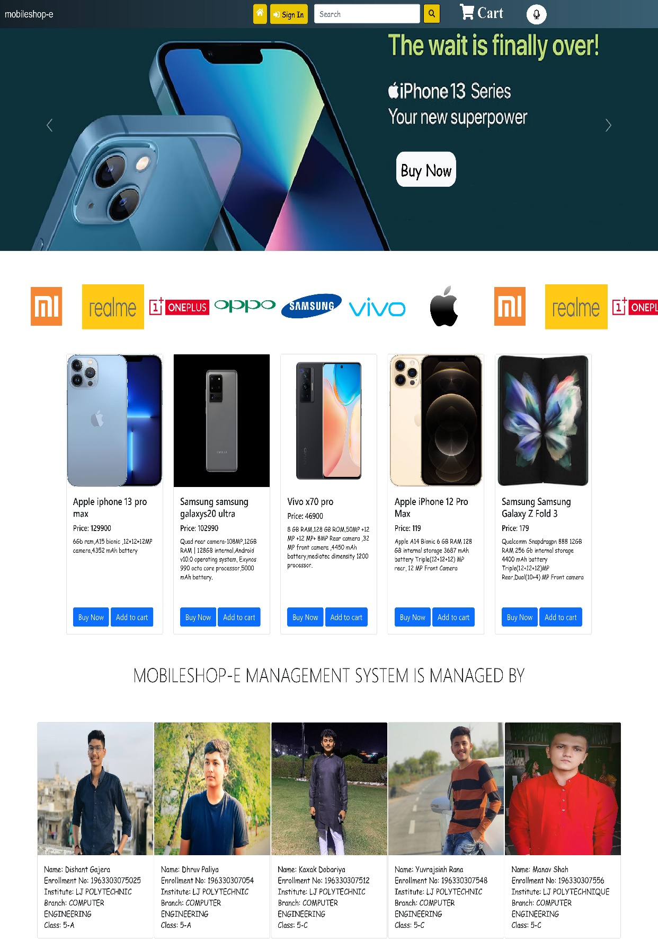
5.5 Design layout 5.5.1 Home page

Slide 22
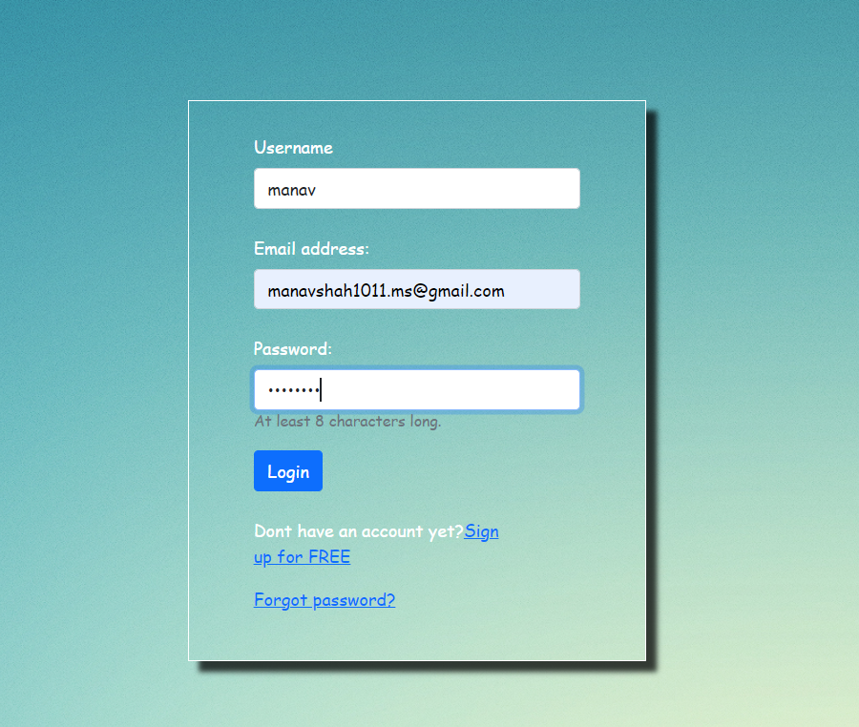
5.5.2 Customer login page

Slide 23
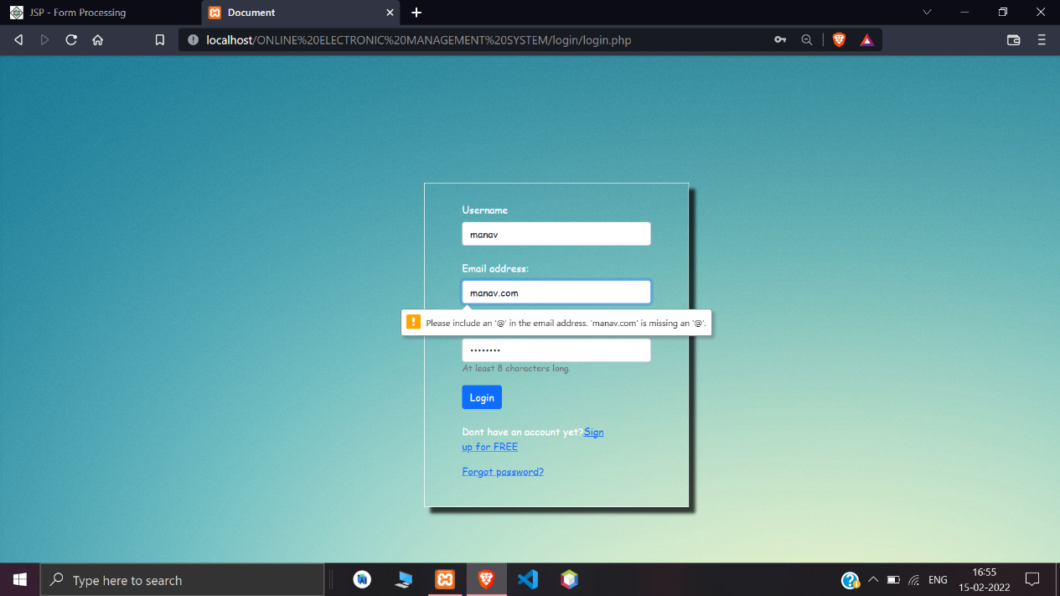
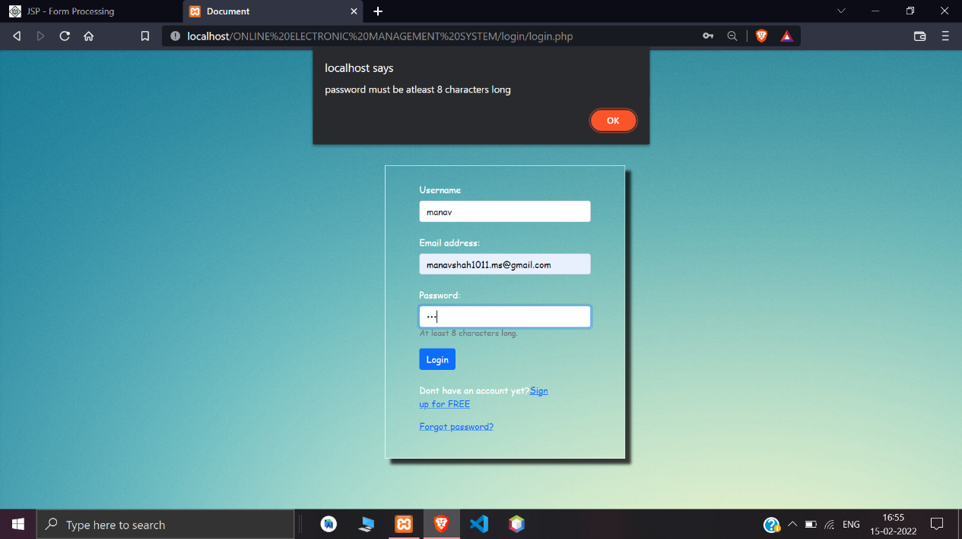
5.5.2 Login page validations

Slide 24
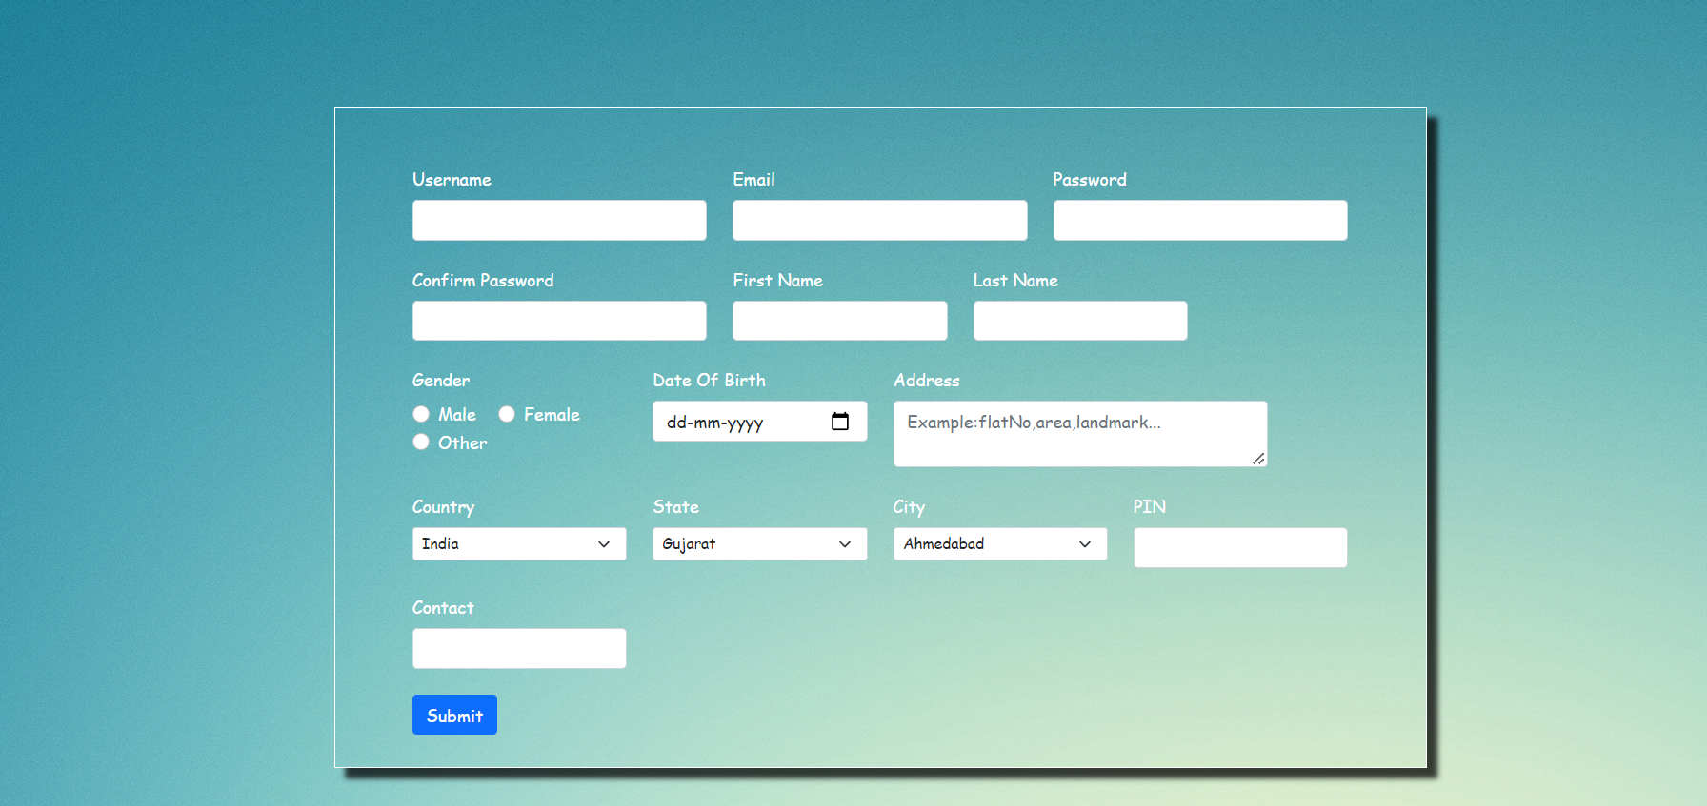
5.5.4 Sign-up page

Slide 25
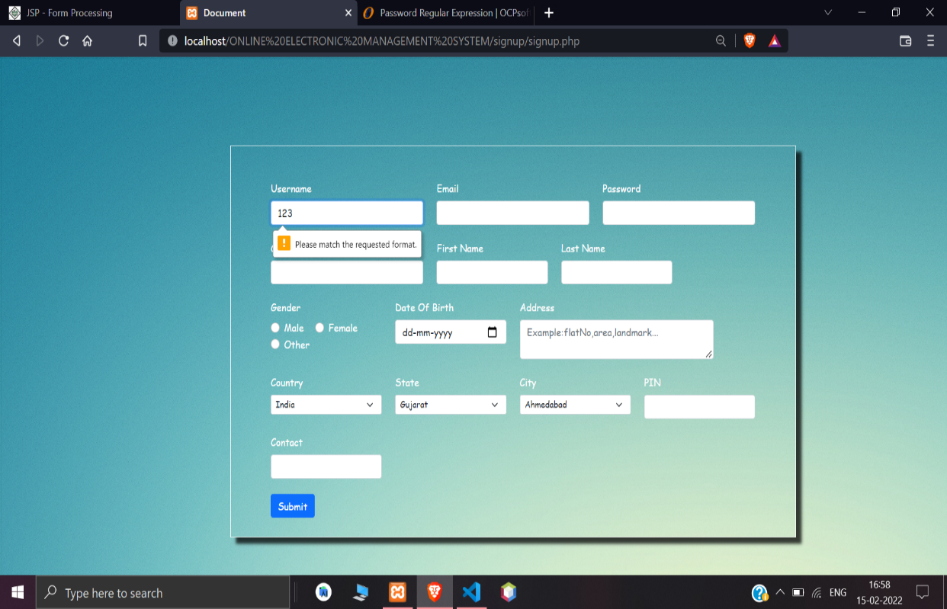
5.5.5 Sign-up page validations

Slide 26
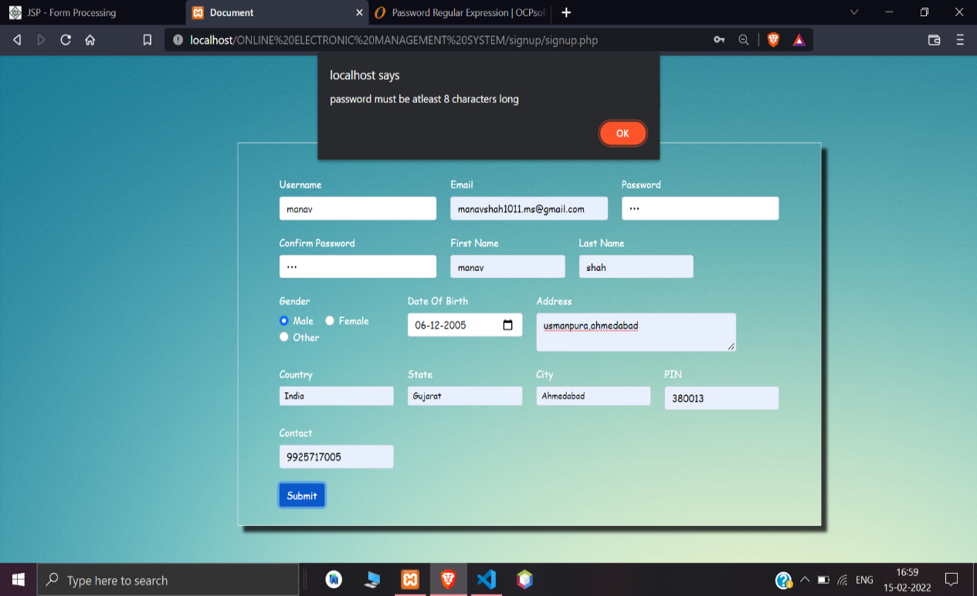


Slide 27
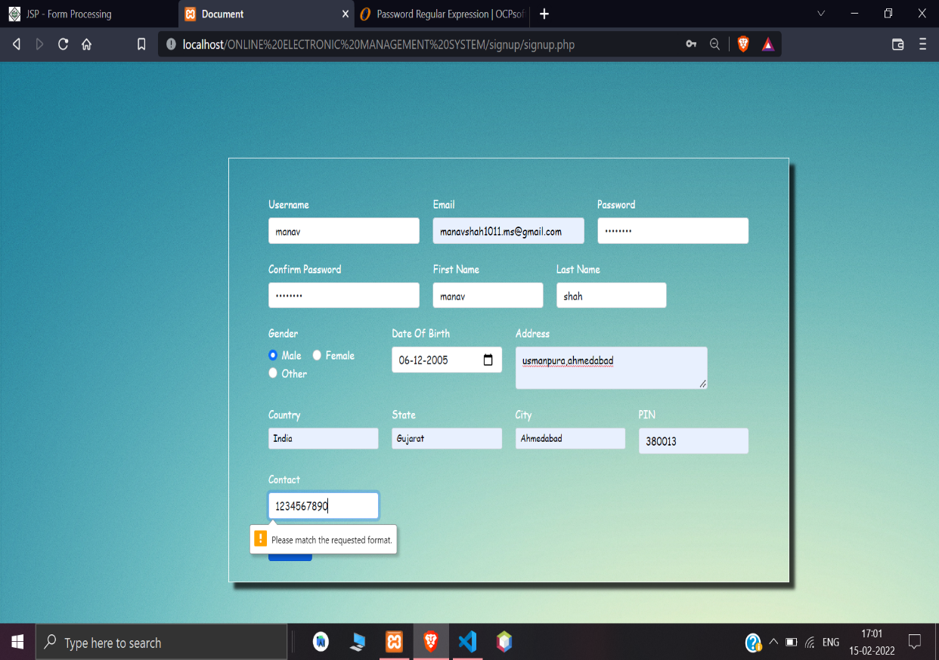
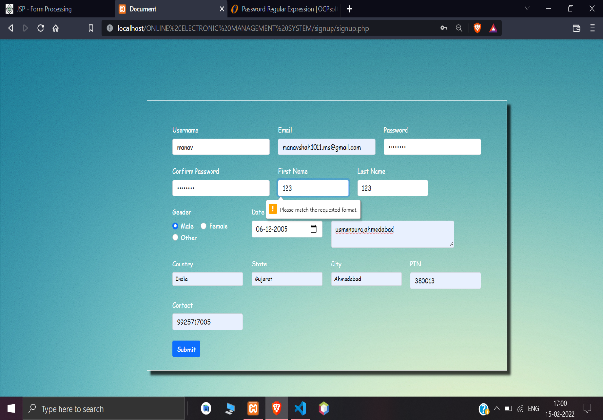

Slide 28
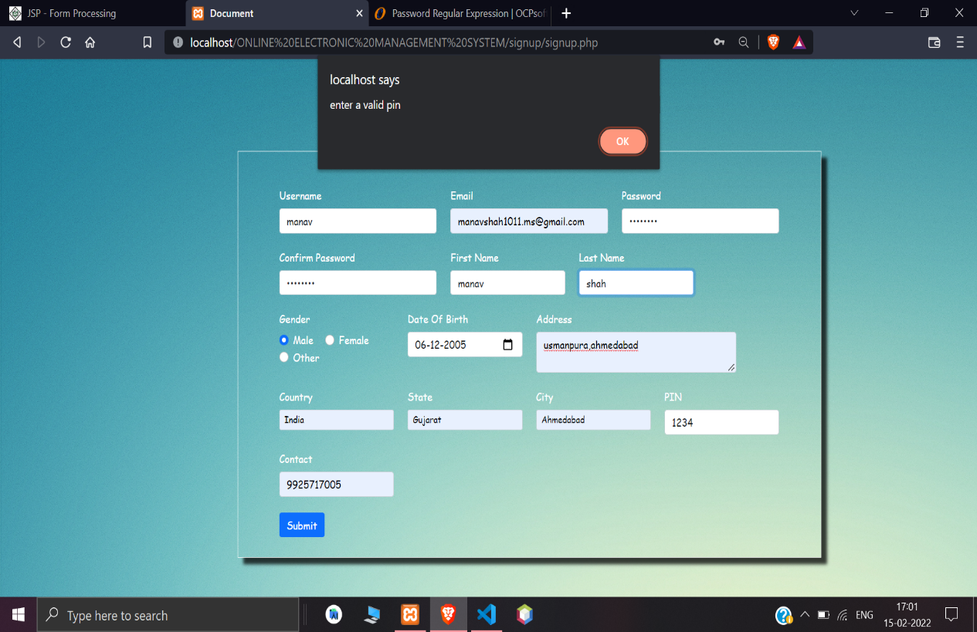

Slide 29
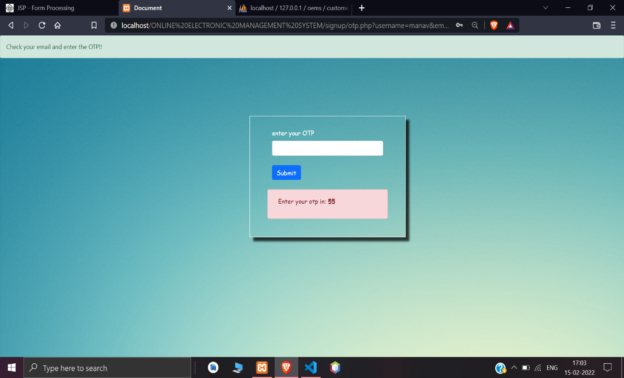
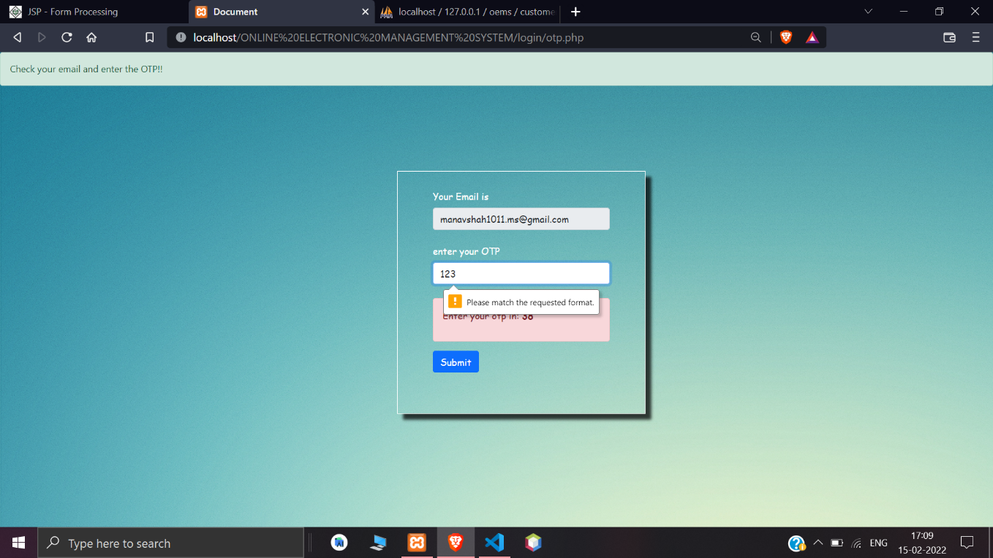
5.5.6 Enter otp for signup

Slide 30
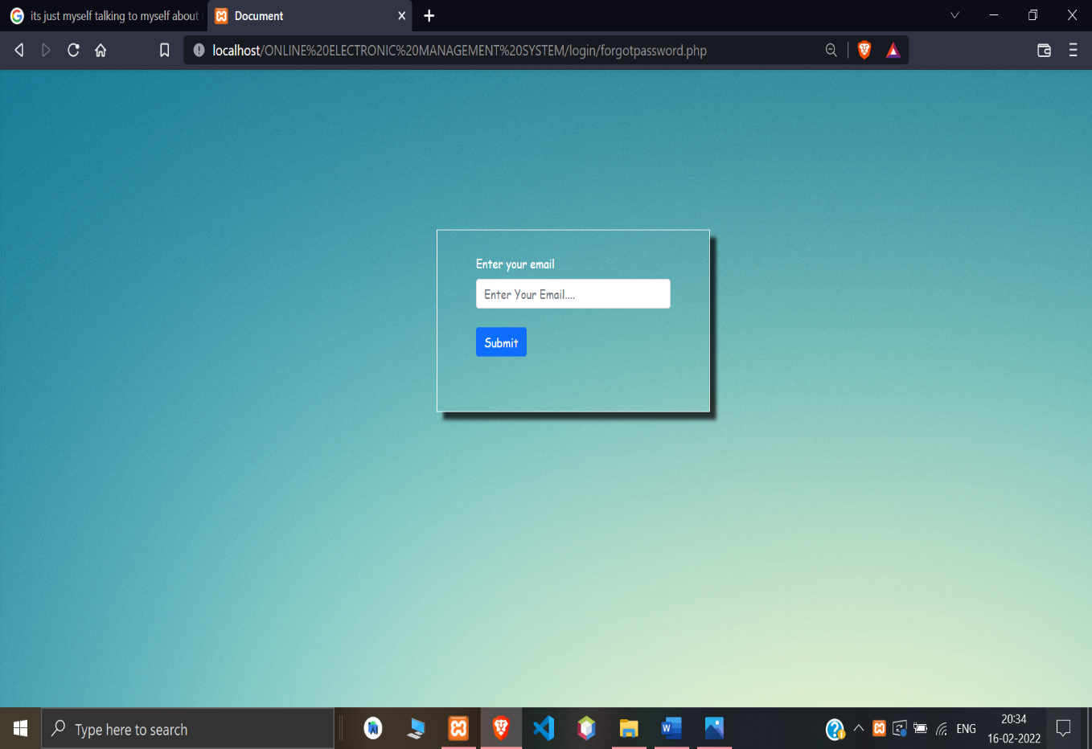
5.5.7 Forgot password page

Slide 31
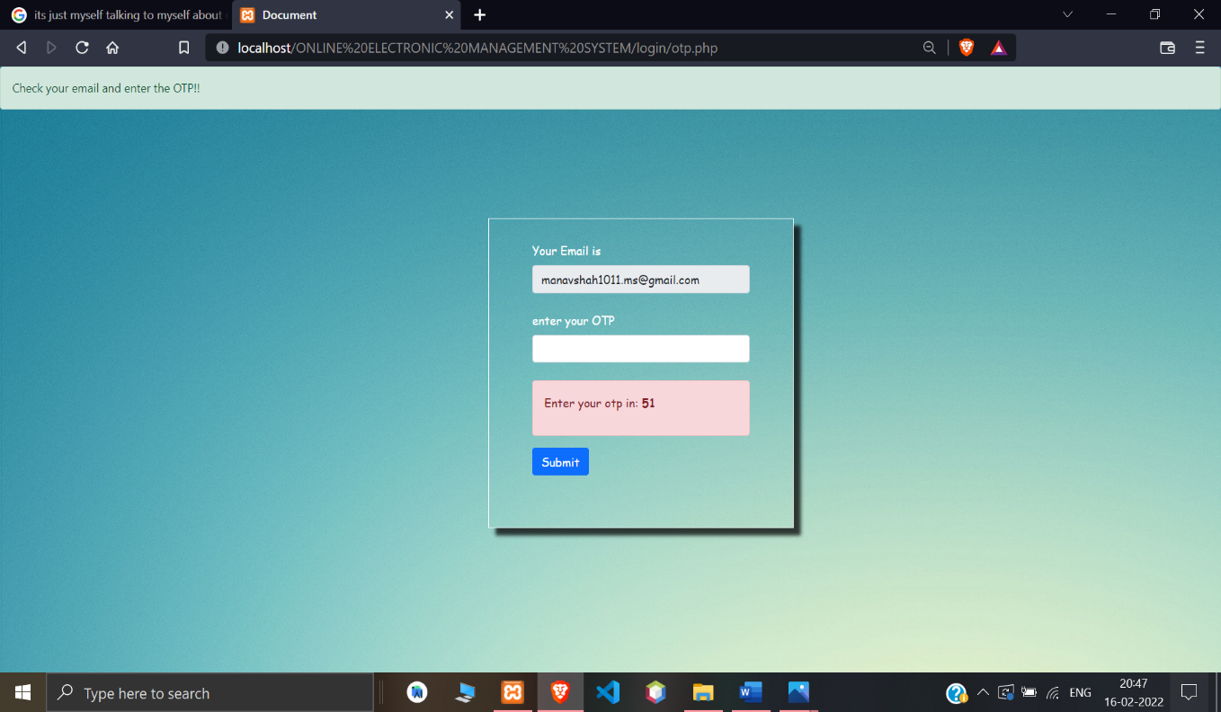
5.5.9 Enter otp for forgot password

Slide 32
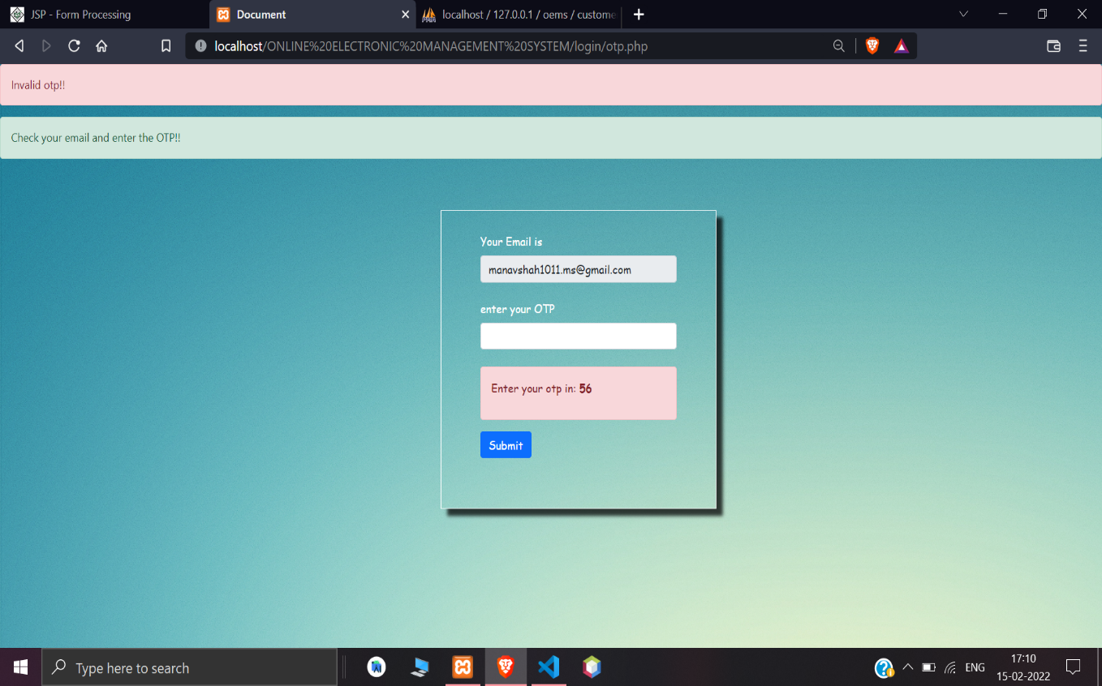
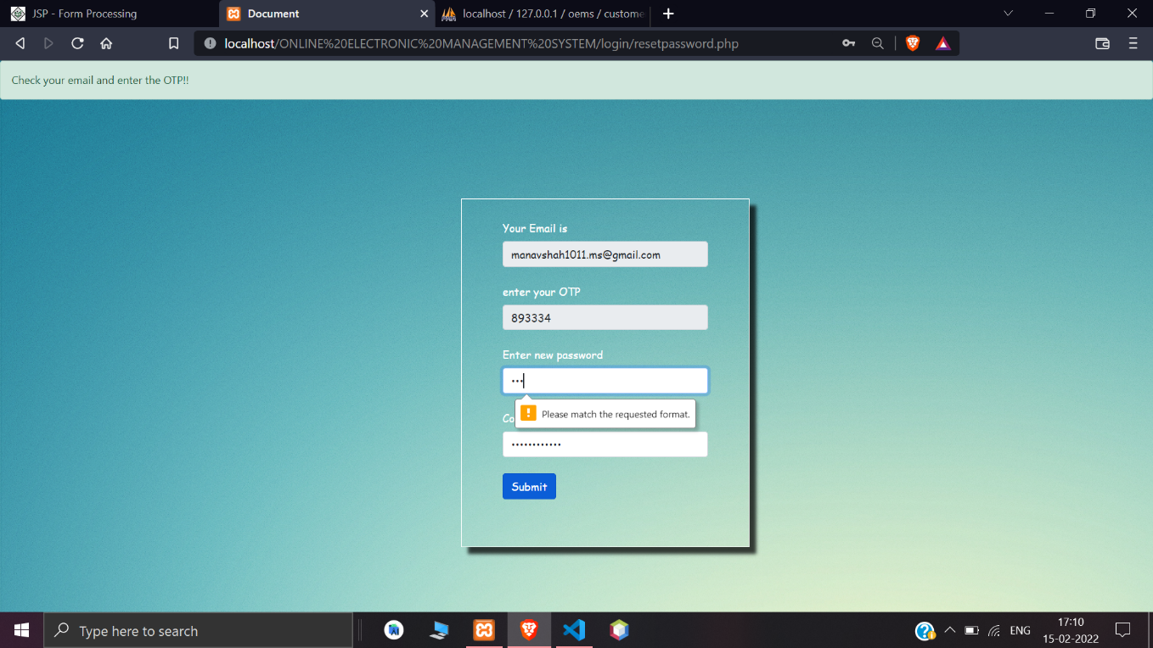
5.5.10 Invalid otp
5.5.10 Reset password

Slide 33
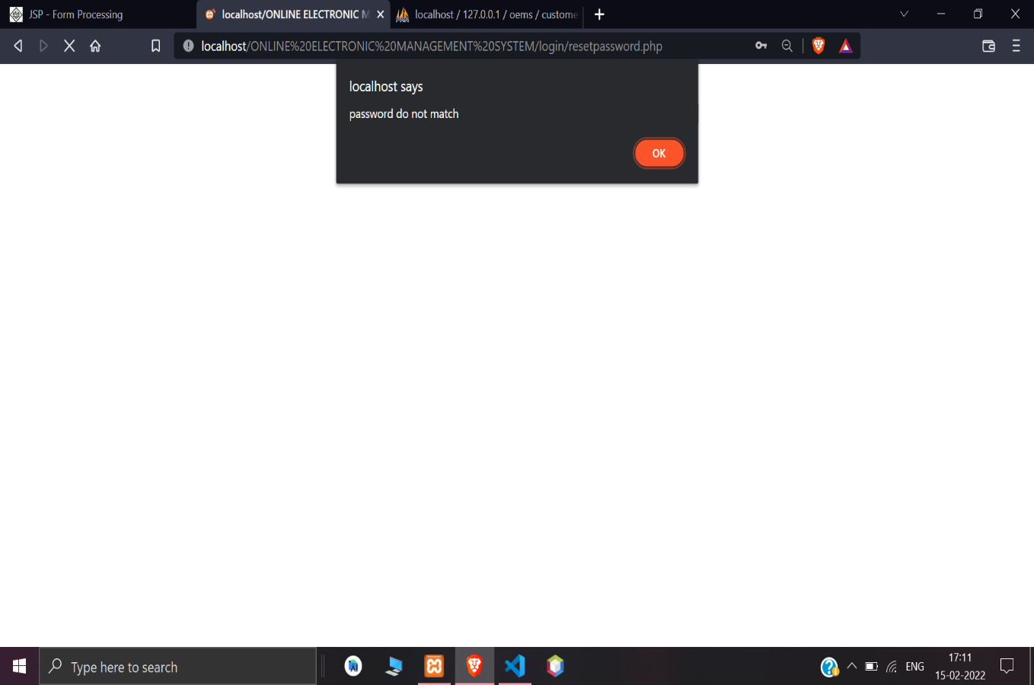
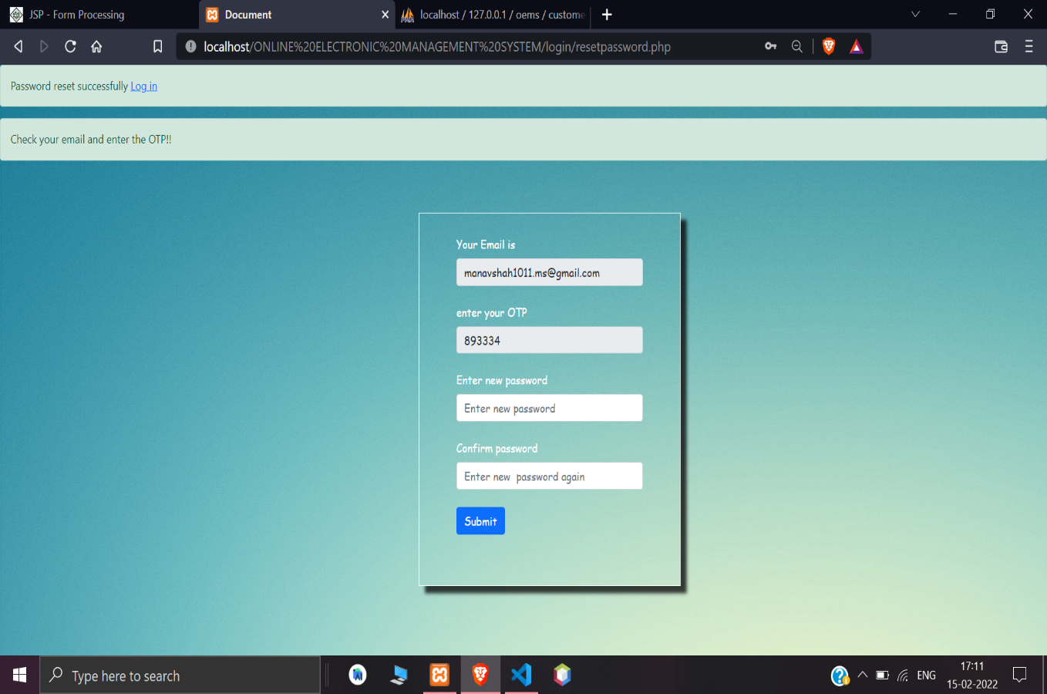

Slide 34
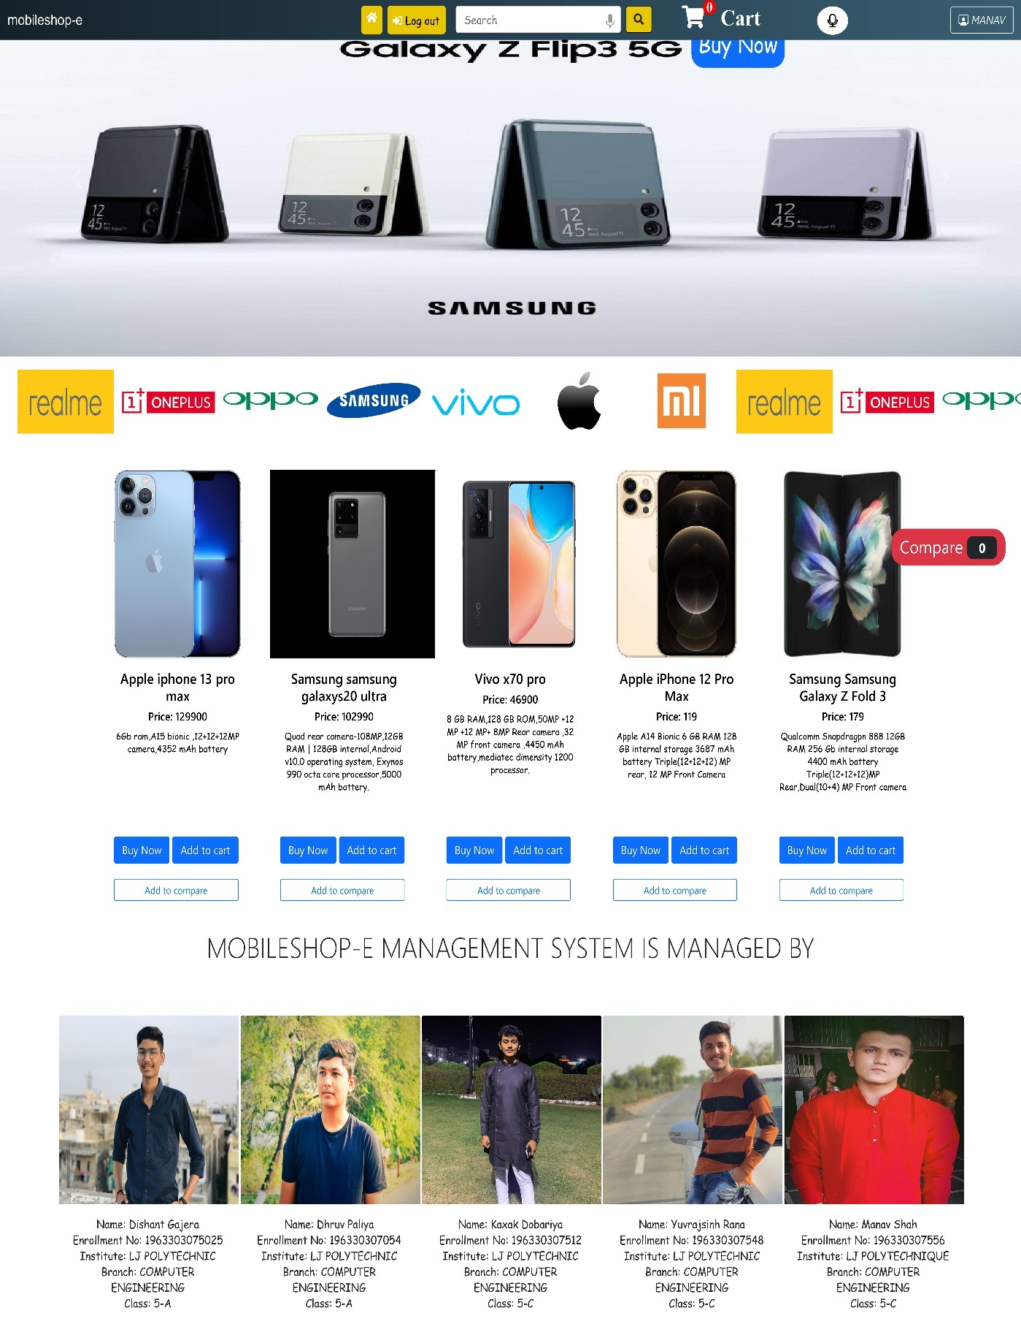
5.5.11 Welcome page

Slide 35
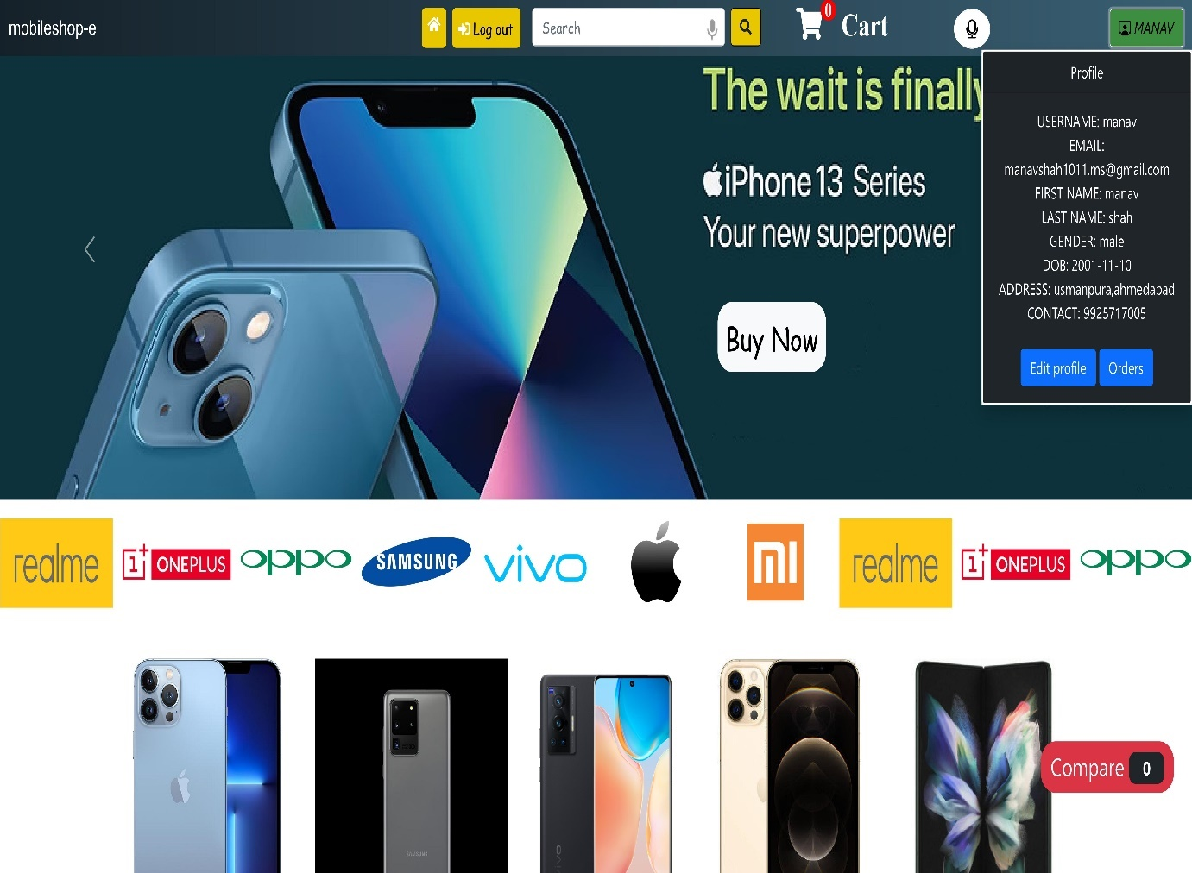
5.5.12 View profile

Slide 36
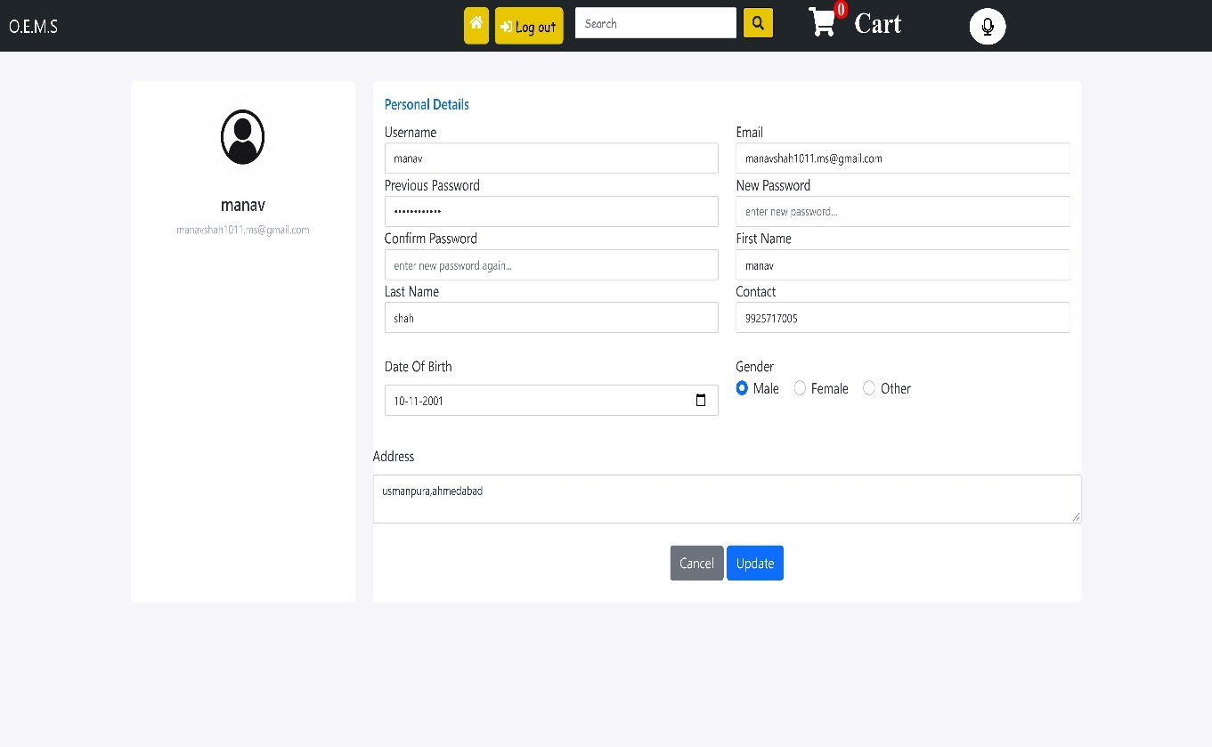
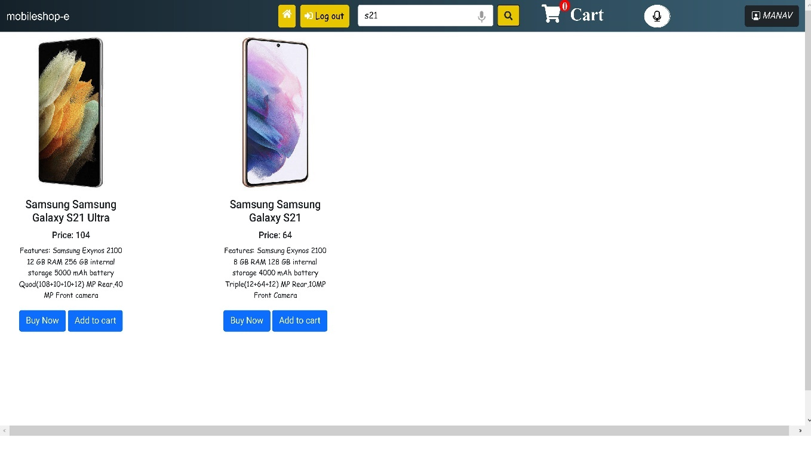
5.5.13 Edit profile
5.5.14 Search product

Slide 37
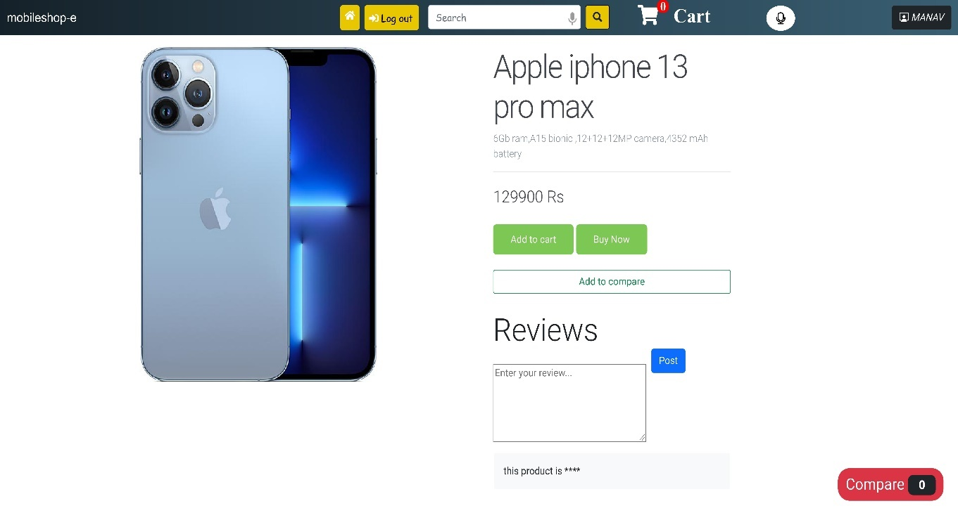
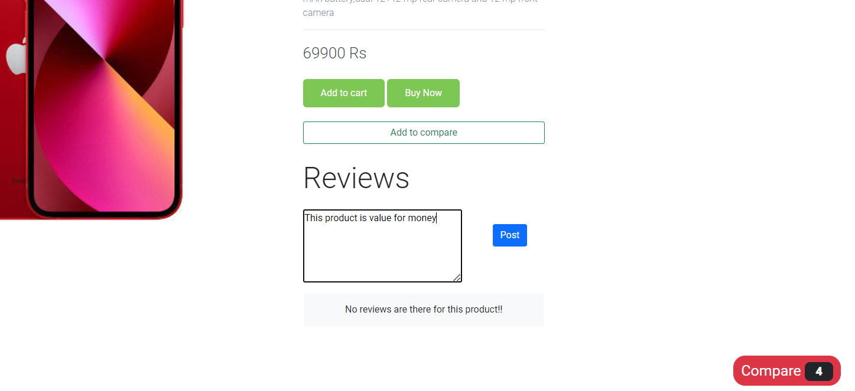
5.5.15 Product detail
5.5.16 Add review

Slide 38
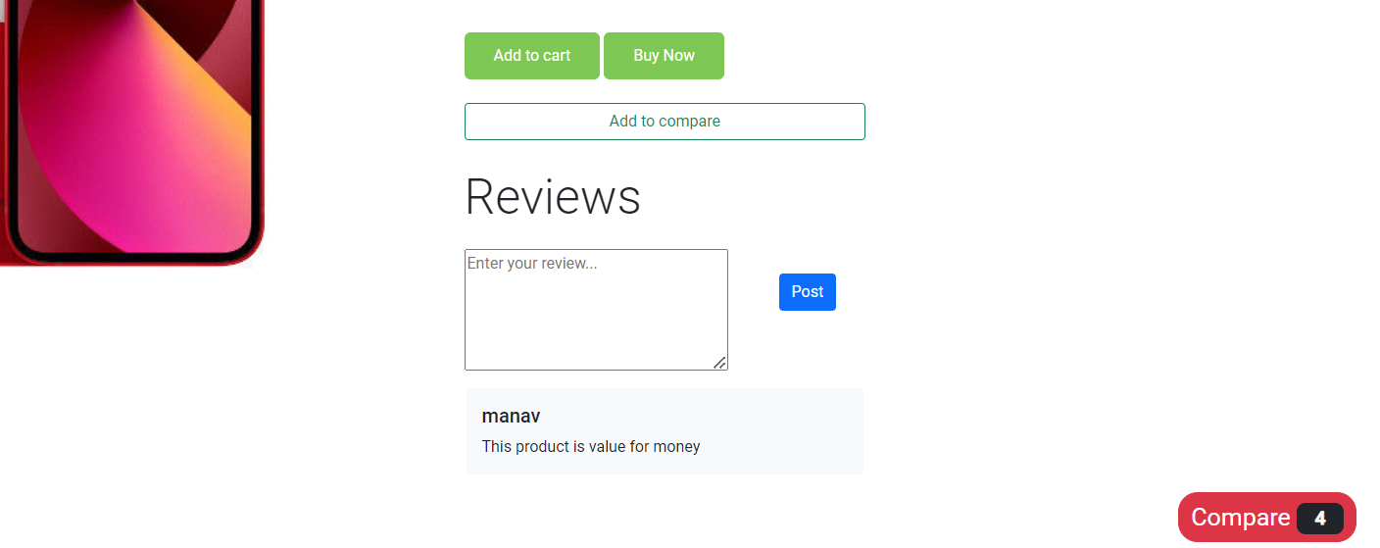
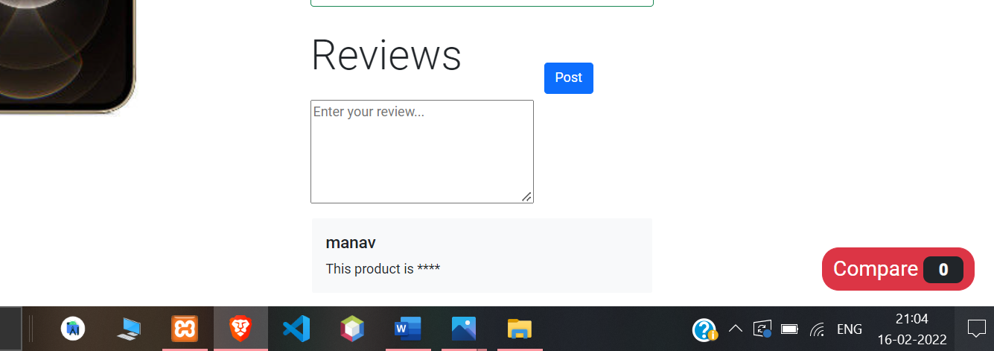
5.5.17 Review validation for abusive words

Slide 39
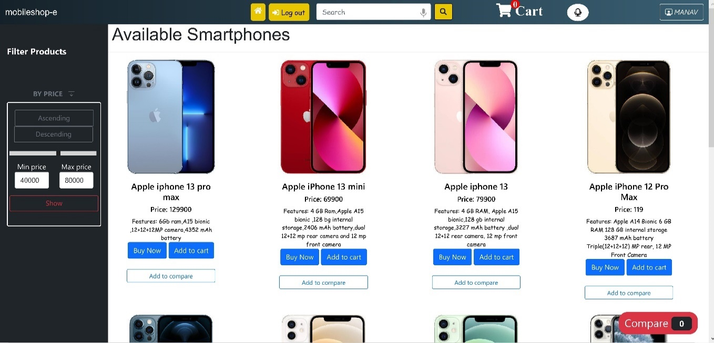
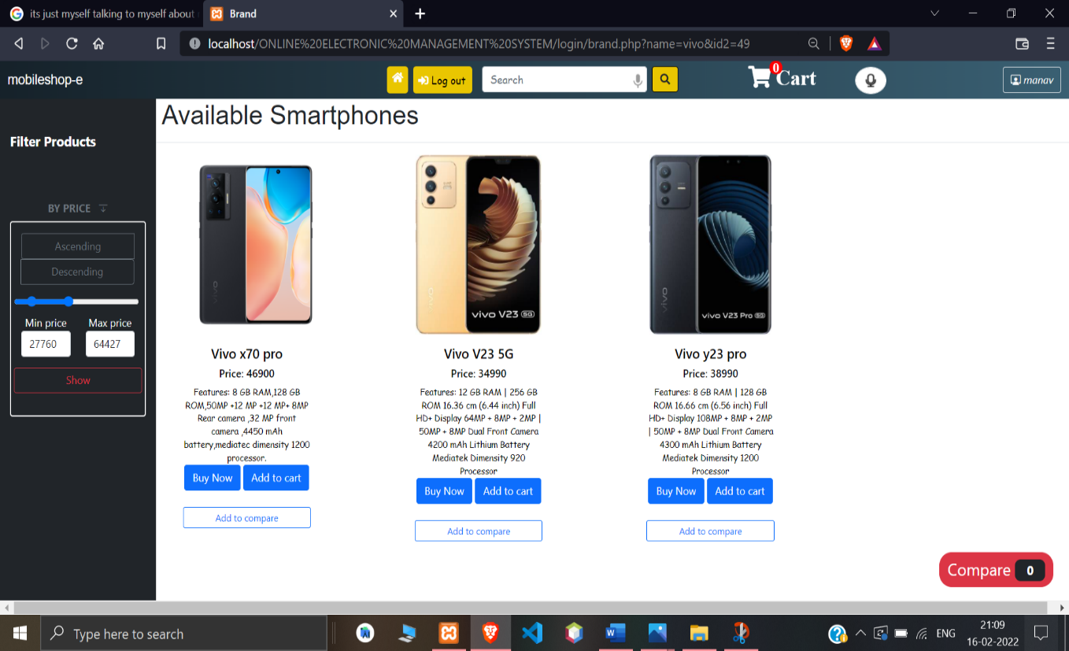
5.5.17 Products in different brands
5.5.18 Filter products by price

Slide 40
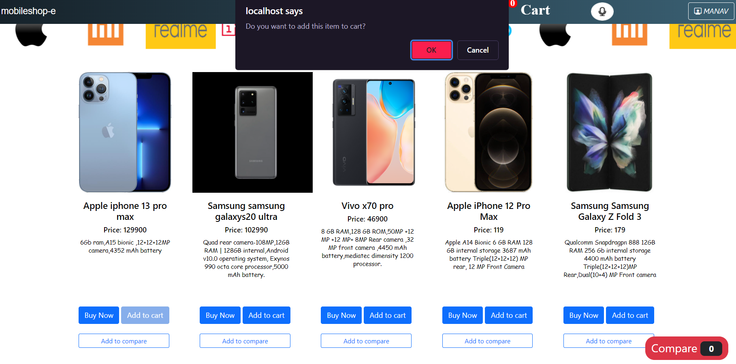
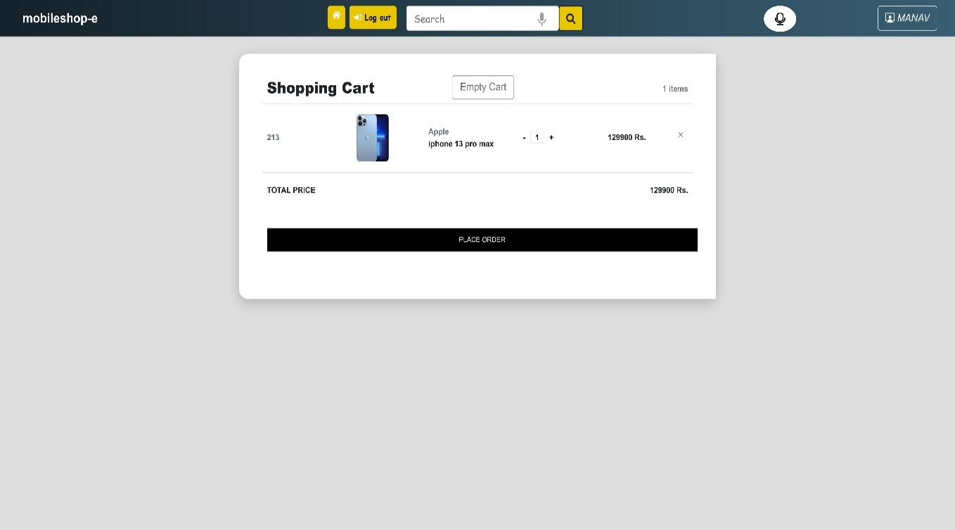
5.5.19 Add to cart
5.5.20 Open cart

Slide 41
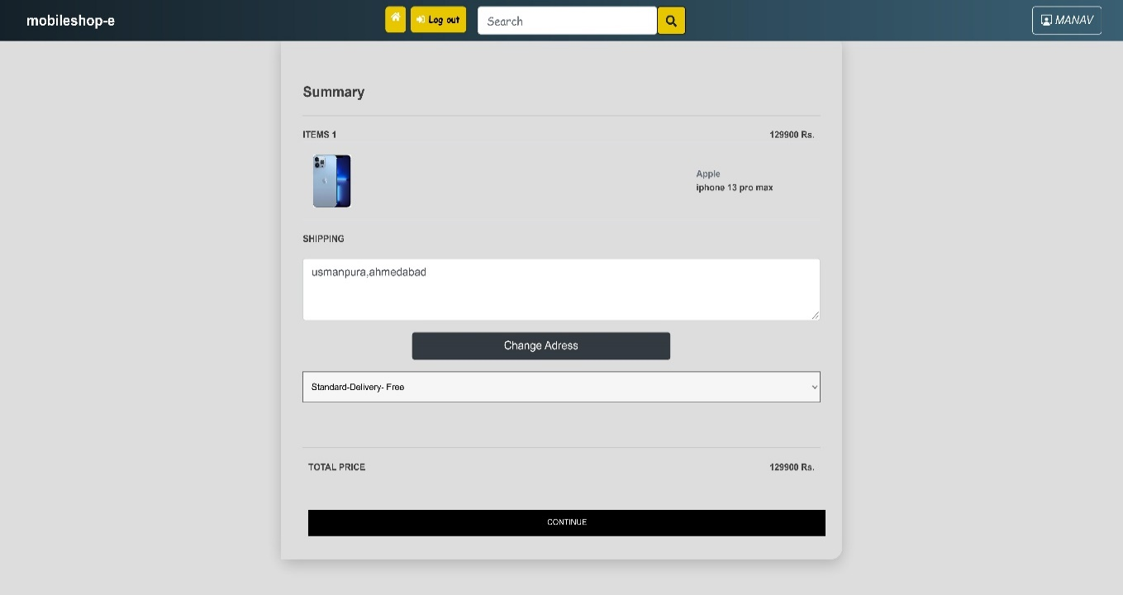
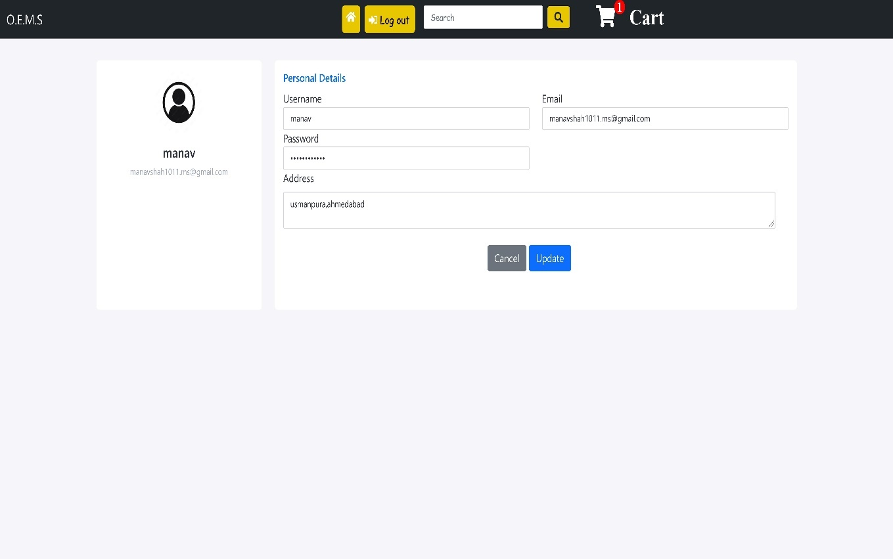
5.5.21 Confirm order
5.5.22 Change address for payment

Slide 42
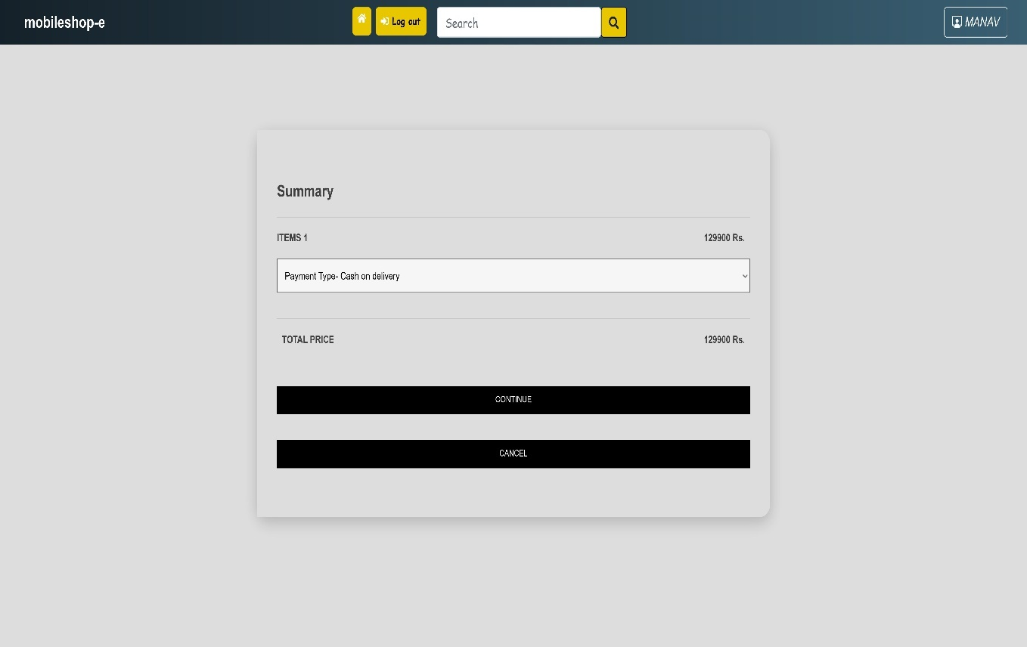
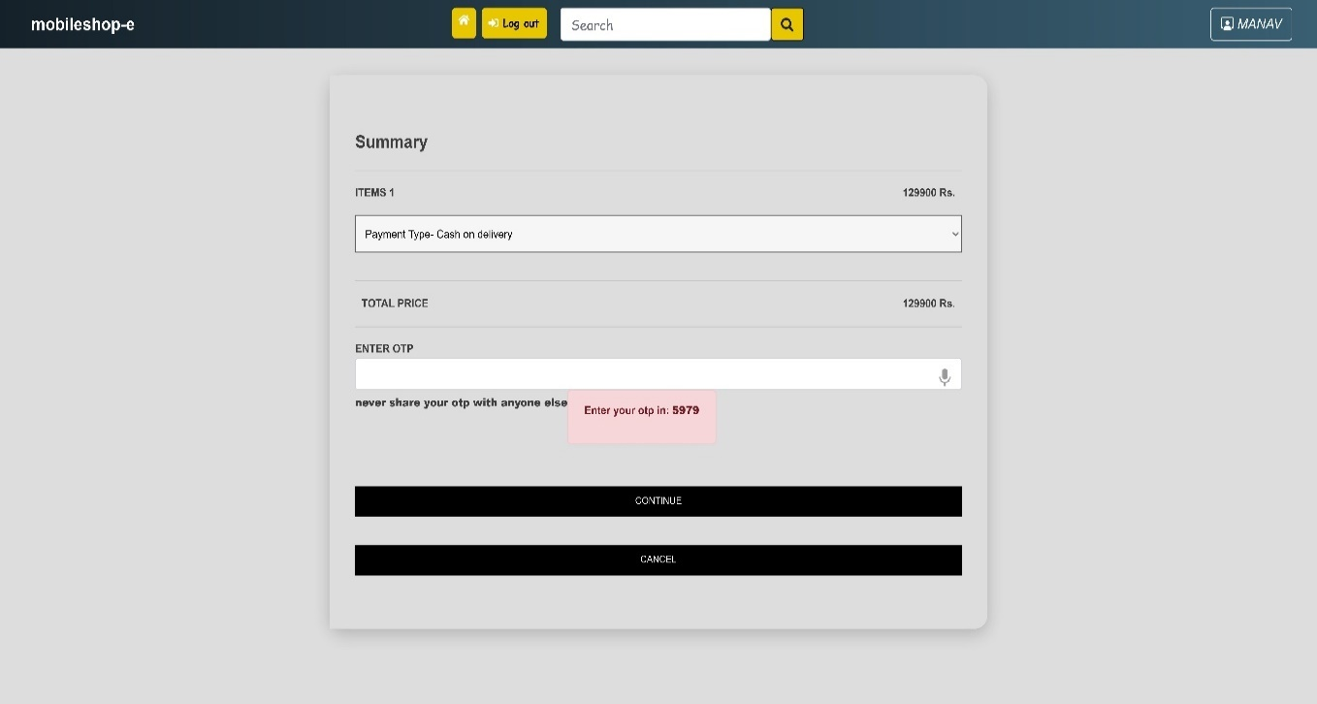
5.5.23 Place order
5.5.24 Confirm payment

Slide 43
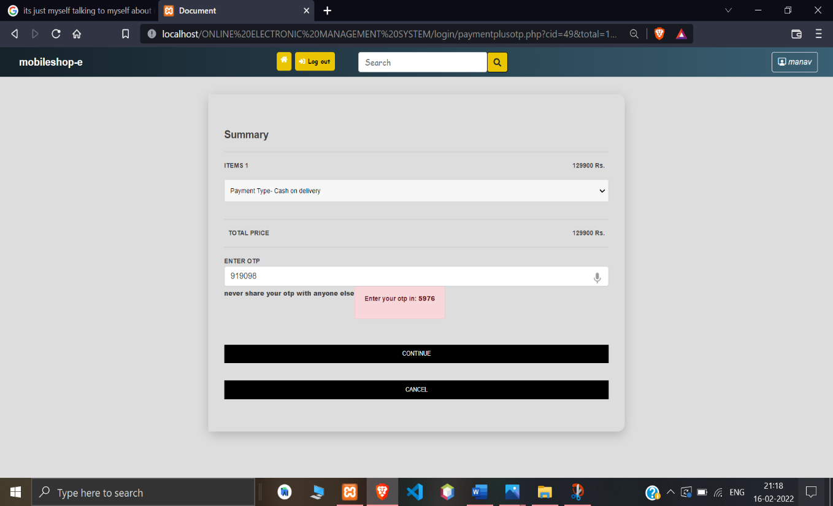
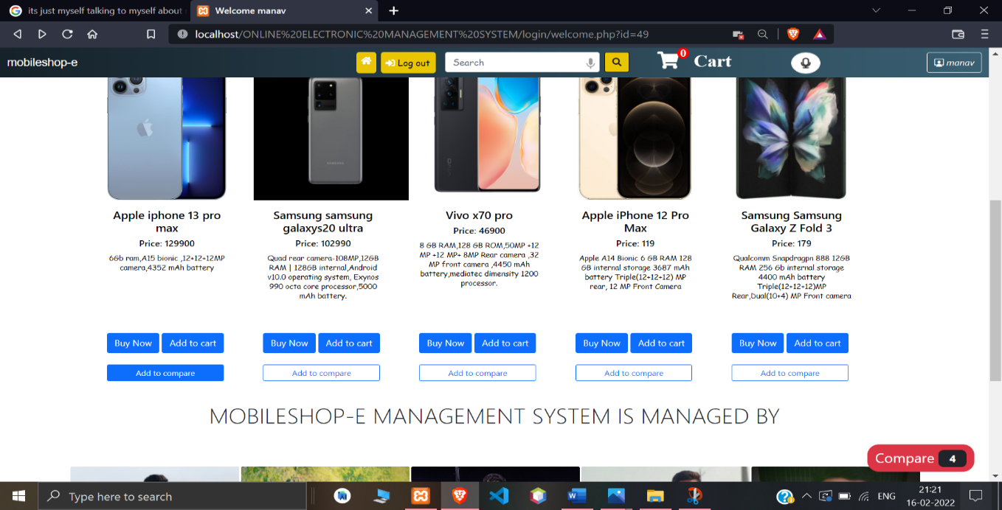
5.5.25 Enter otp for payment
5.5.26 Add to compare

Slide 44
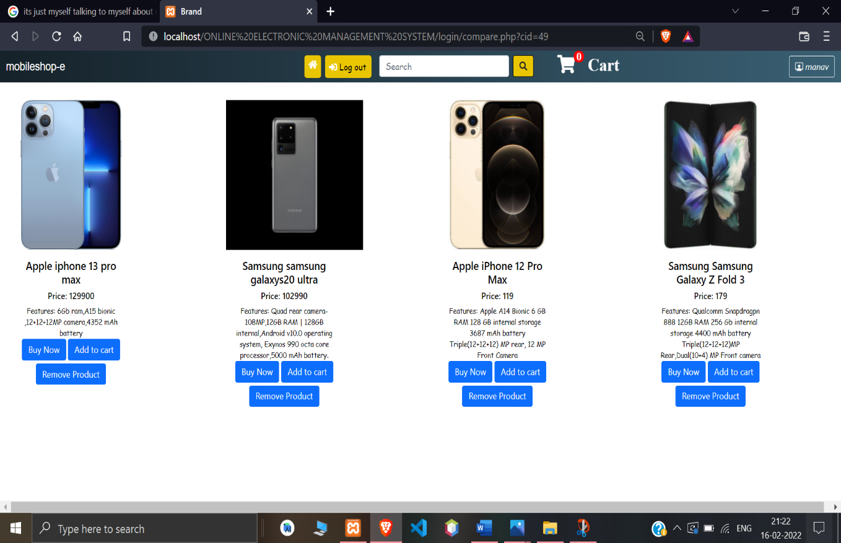
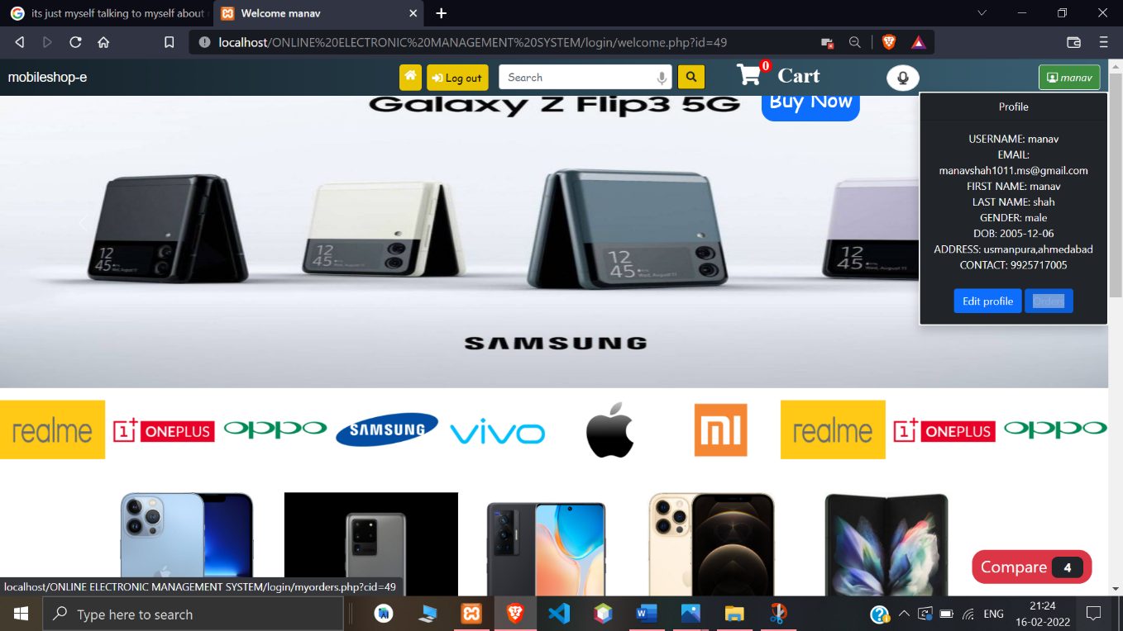
5.5.27 Compare page
5.5.28 Go to my orders page

Slide 45
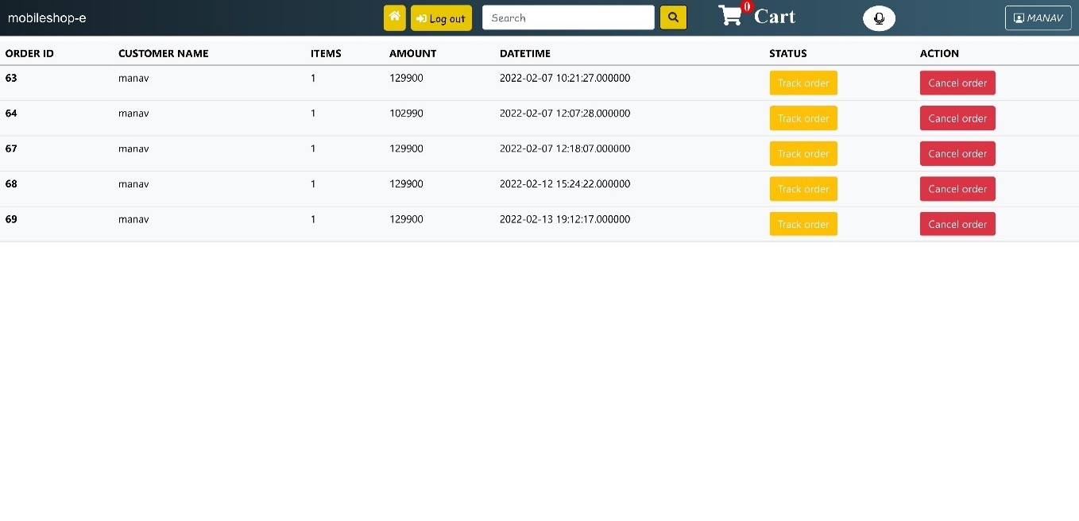
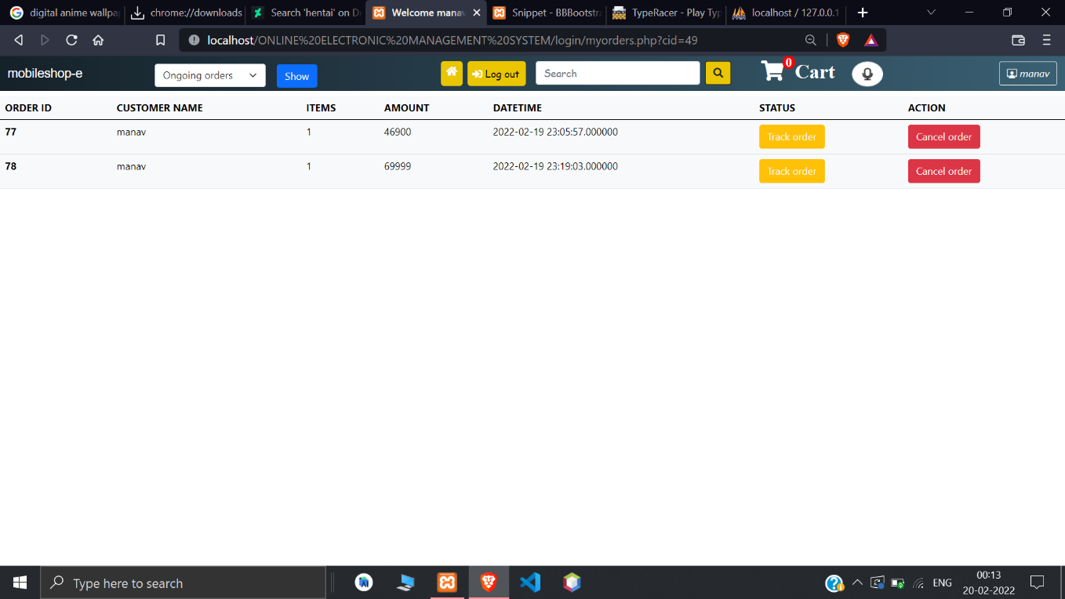
5.5.29 My orders page
5.5.30 Ongoing orders

Slide 46
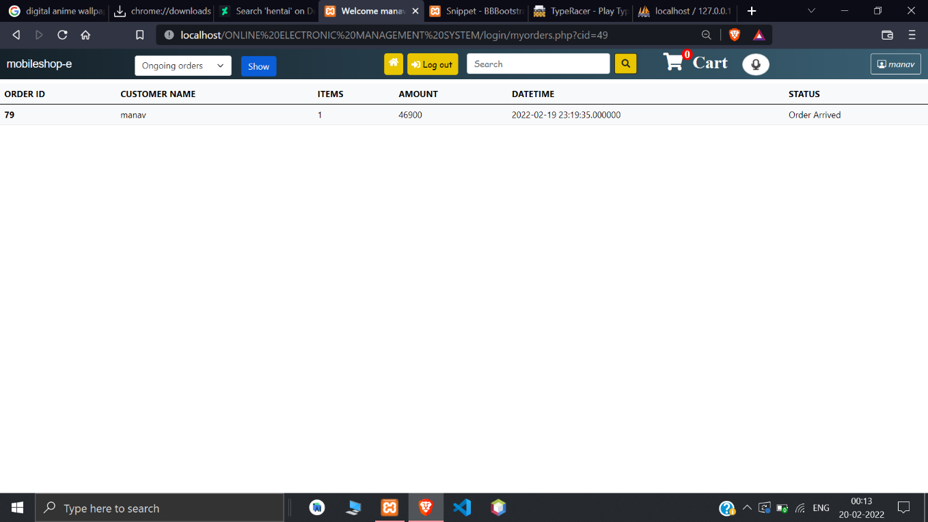
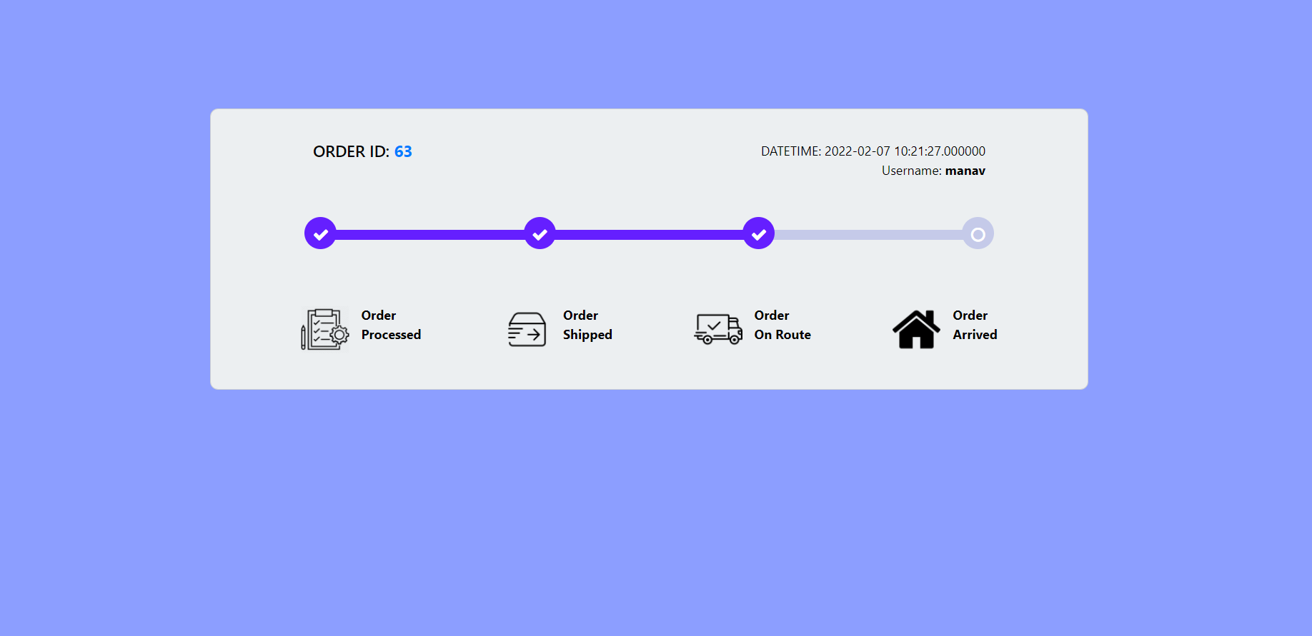
5.5.31 Completed orders
5.5.32 Track order

Slide 47
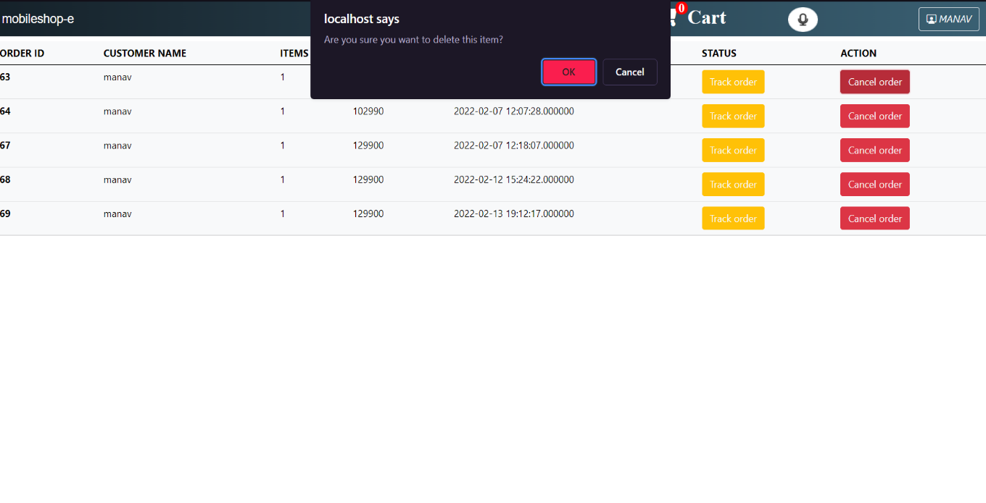
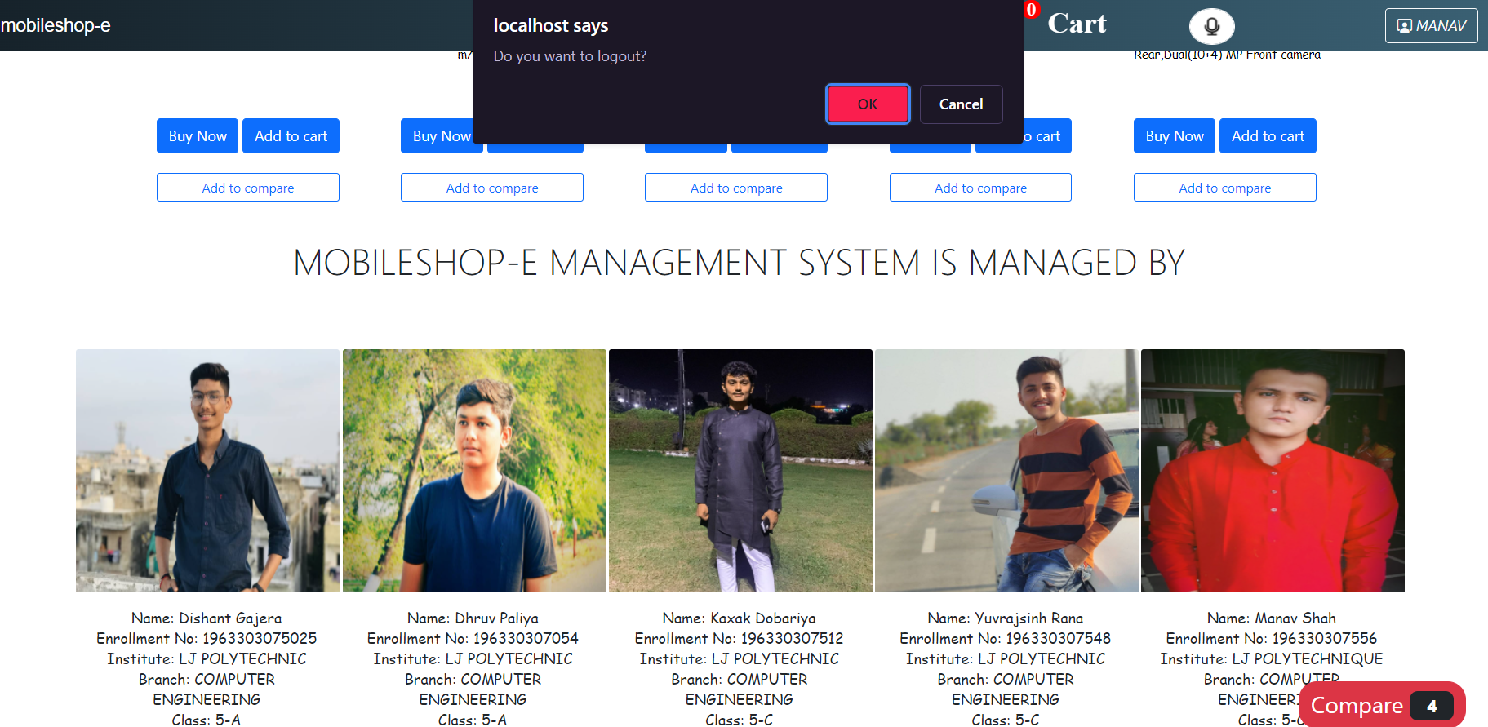
5.5.33 Delete order
5.5.34 Logout for user

Slide 48
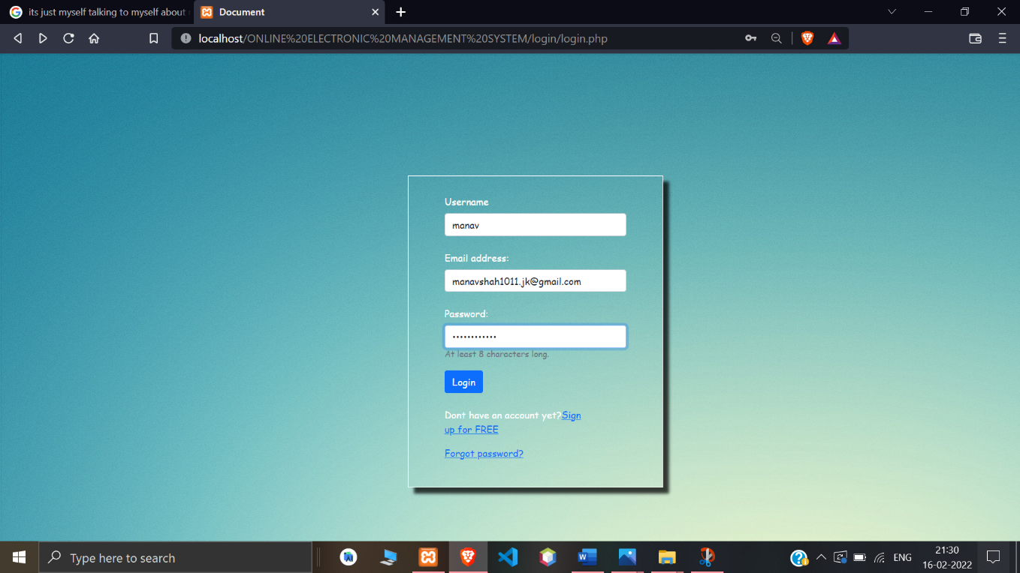
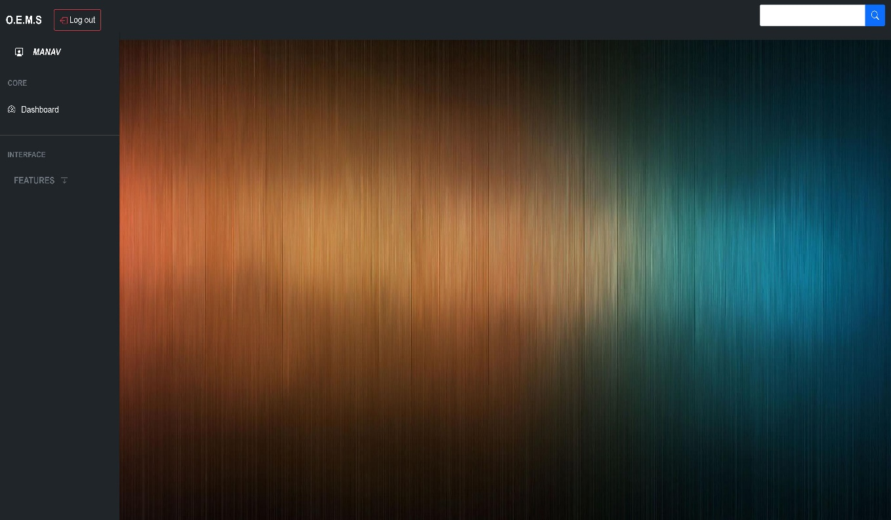
5.5.35 Admin login
5.5.36 Admin home page

Slide 49
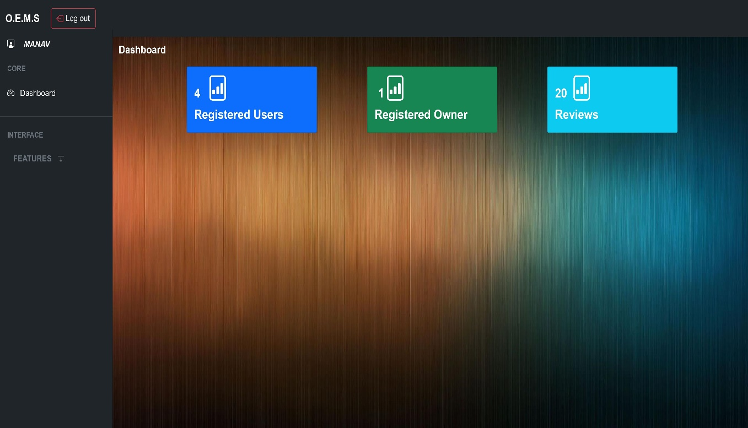
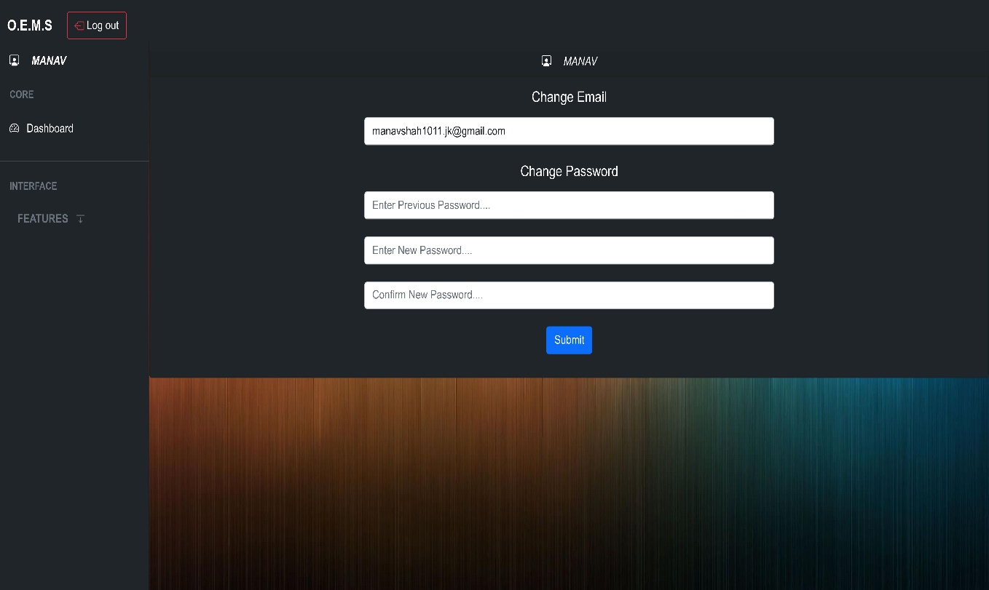
5.5.37 Admin dashboard
5.5.38 Change profile

Slide 50
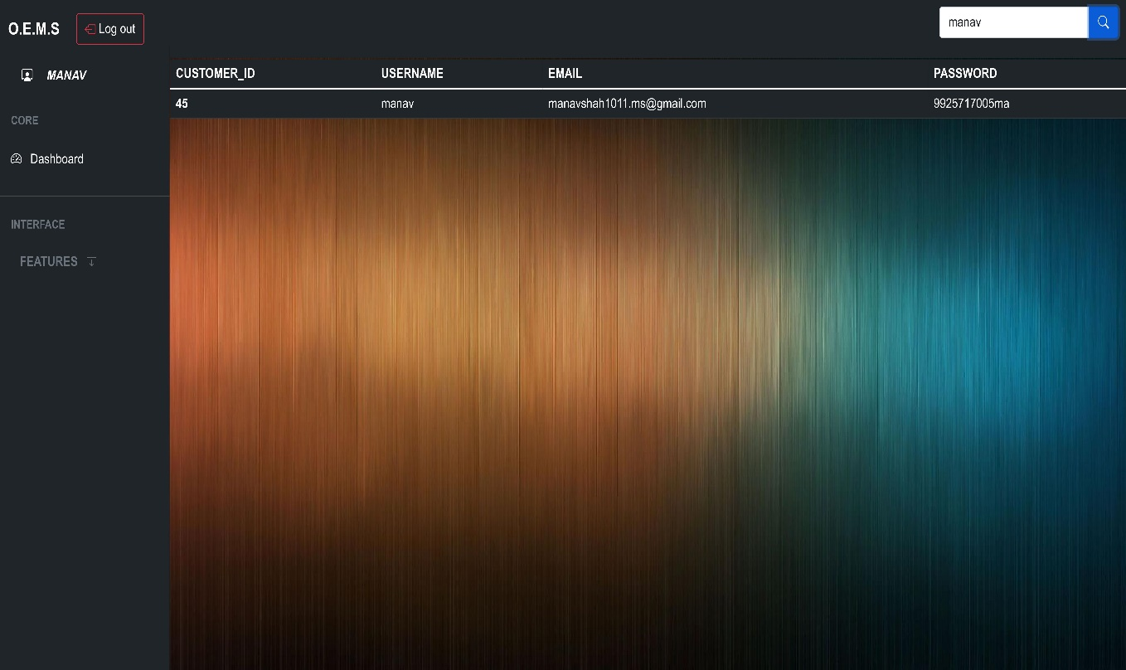
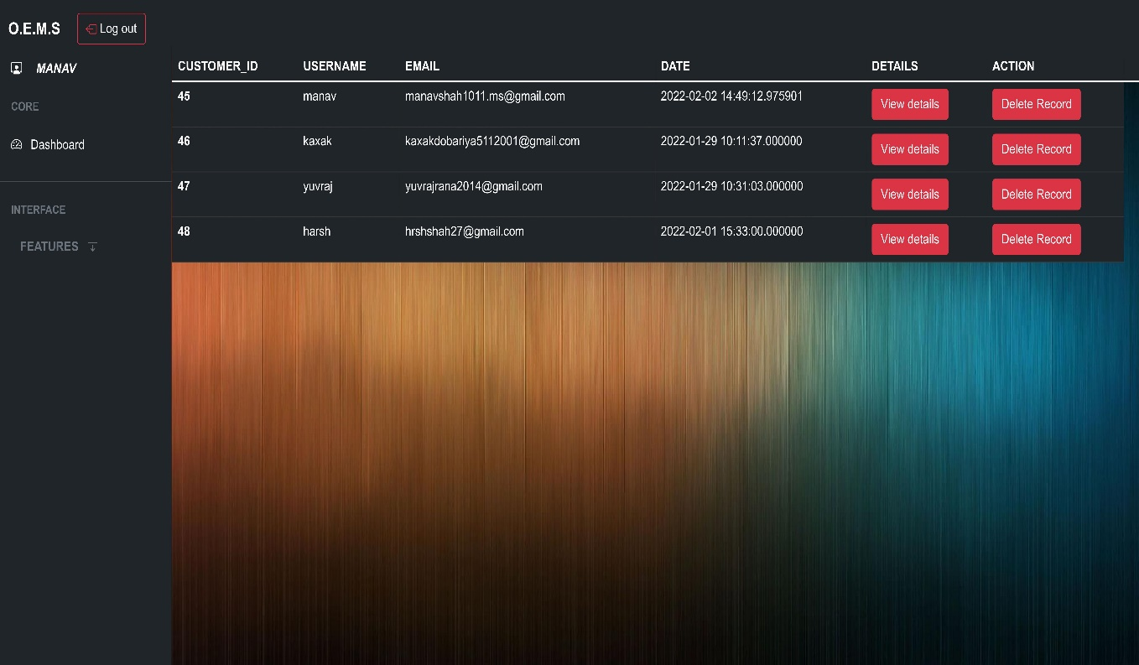
5.5.39 Search user
5.5.40 View users

Slide 51


5.5.41 View shopkeeper
5.5.43 Logout for admin

Slide 52


5.5.43 Shopkeeper login
5.5.44 Shopkeeper home

Slide 53


5.5.45 Add product
5.5.46 Add brand

Slide 54


5.5.47 Search product
5.5.48 Shopkeeper Dashboard

Slide 55


5.5.49 Edit profile
5.5.50 Registered users

Slide 56


5.5.51 Delete user
5.5.52 User details

Slide 57


5.5.53 Registered brands
5.5.54 Delete brand

Slide 58


5.5.55 Registered products
5.5.56 Delete product

Slide 59


5.5.57 Edit products
5.5.58 Registered orders

Slide 60


5.5.59 Ongoing orders
5.5.60 Completed orders

Slide 61


5.5.61 Deleted orders
5.5.62 Change order status

Slide 62

5.5.63 Logout for shopkeeper

Slide 63

CHAPTER 6 TESTING
6.1 Testing Methods
6.1.1 Black Box Testing
Black Box Testing is also known as Behavioral Testing or Functional Testing. It is a technique of testing without having any knowledge of the internal working of the application.

Slide 64

6.1.2 White Box Testing
White Box Testing is a software testing method in which the internal structure/design/implementation of the item being tested is known to the tester.
The tester chooses inputs to exercise paths through the code and determines the appropriate outputs.
This method is named so because the software program, in the eyes of the tester, is like a white/transparent box; inside which one clearly sees.

Slide 65


Example:
In the following example, if the user enters a valid otp in 60 seconds then he will be able to reset his password but if the he enters the invalid the otp the user will be prompted to re-enter the otp.

Slide 66
CONCLUSION
It was a wonderful experience to work on this project. By doing so we have learnt a lot. This project has taken us into many phases of project development and gave us a real insight of how a website of particular shop is managed online. This project will result in people being able to buy their desired products easily without walking into the shop itself.

Slide 67
BILBIOGRAPHY
Book References:
Rajib mall “Fundamental of software engineering”, prentice hall learning India private limited. [Edition 4].
Jon duckett, “HTML and CSS: Design and build websites”, Wiley. [Edition 2].
W.Jason Gilmore, “Beginning of PHP and MySQL from novice to professional”, Apress. [Edition 4].
David sklar, “Learning PHP5, oreilly [edition 5].
Website References:
“W3Schools”, https://www.w3schools.com/php/default.asp
“PHP”, https://www.php.net/manual/en/function.session-id.php
“Bootstrap”, https://getbootstrap.com/docs
“Geek for Geeks”, https://www.geeksforgeeks.org/php/
“PHP Buddy”, https://www.phpbuddy.com/
“JQuery CDN”, https://code.jquery.com/
“OWL Carousel”, https://owlcarousel2.github.io/OwlCarousel2/

